Slide 1
PERSONAL INJURY
Julian Allen

Slide 2
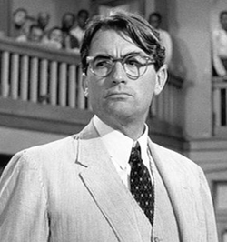
Plaintiff v. Defense
Hours v. Contingency
Client
Values

Slide 3

Is it a case?
  1. Damages
  2. Liability
  3. Collectibility

Slide 4
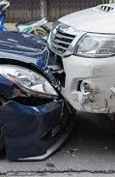
Now what?
Intake
Medical Records/Bills
Demand Letter
  S.C. Code § 38-77-250
  Tyger River, 170 S.C. 286, 170 S.E. 346 (1933)

Slide 5
To File or Not to File?
Denied Liability
Value Disagreement
Need More Information
Not without cost, time, burden!

Slide 6
The Litigation Process
Know your Statute of Limitations
File Summons and Complaint with Coversheet (e-file now…)
Jury trial?
Answer — affirmative defenses
Discovery
Subpoenas
Depositions — what’s the point?!
  What are you trying to learn?
  Video
  Use at trial
  Value
Mandatory mediation 300 days after filing. Who’s there?
Trial. Lost art?

Slide 7

Things to consider….
Venue
Jurisdiction: State v. Federal
Pleading into coverage
Punitive Damages (Poole case)
  25/50/25

Slide 8
It is not the critic who counts; not the man who points out how the strong man stumbles, or where the doer of deeds could have done them better. The credit belongs to the man who is actually in the arena, whose face is marred by dust and sweat and blood; who strives valiantly; who errs, who comes short again and again, because there is no effort without error and shortcoming; but who does actually strive to do the deeds; who knows great enthusiasms, the great devotions; who spends himself in a worthy cause; who at the best knows in the end the triumph of high achievement, and who at the worst, if he fails, at least fails while daring greatly, so that his place shall never be with those cold and timid souls who neither know victory nor defeat.
–President Teddy Roosevelt

