Slide 2

Human Trafficking in South Carolina
and the U.S. Attorney's response
Jamie Lea Schoen
Assistant United States Attorney
District of South Carolina

Slide 3
THE CRIME: What is Human Trafficking?
The Federal definitions:
Sex Trafficking
18 U.S.C. § 1591
Defendant recruited/enticed harbored/transported/provided/ obtained/maintained/advertised/ patronized/solicited the victim;
by force/fraud/ coercion*
to cause the victim to engage in a commercial sex act;
*force/fraud/coercion NOT required if the victim is a minor
Penalties: 15 to Life + mandatory restitution
Forced Labor
18 U.S.C. § 1589
Provides/obtains/benefits from the venture that provides/obtains labor/services:
By one of these four prohibited means:
Force/restraint
Threats of serious harm or restraint (to the victim or another person)
Abuse of legal process
Coercive scheme/plan/pattern
Penalties: 0 - 20, or up to Life if aggravating factors + mandatory restitution

Slide 4
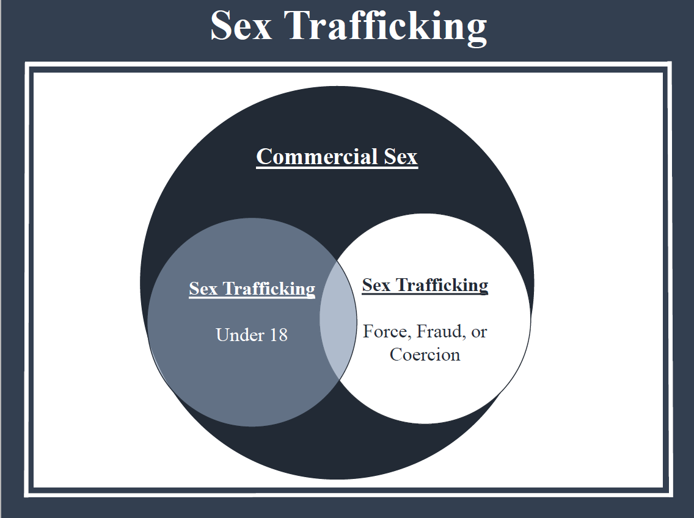
Notes:
SMT

Slide 5
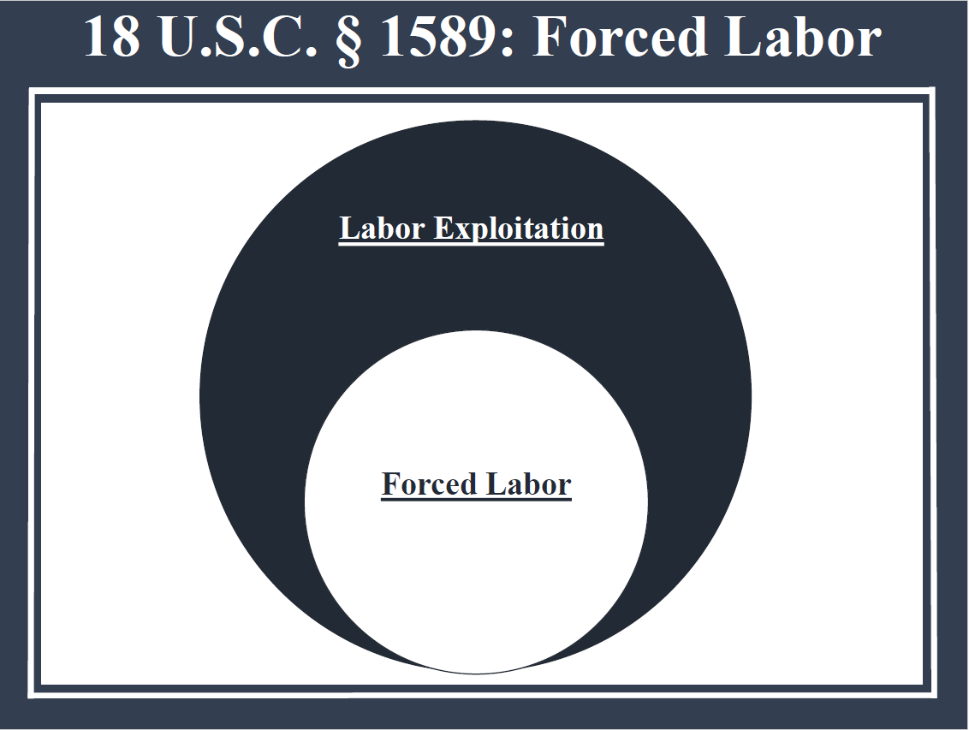

Slide 6
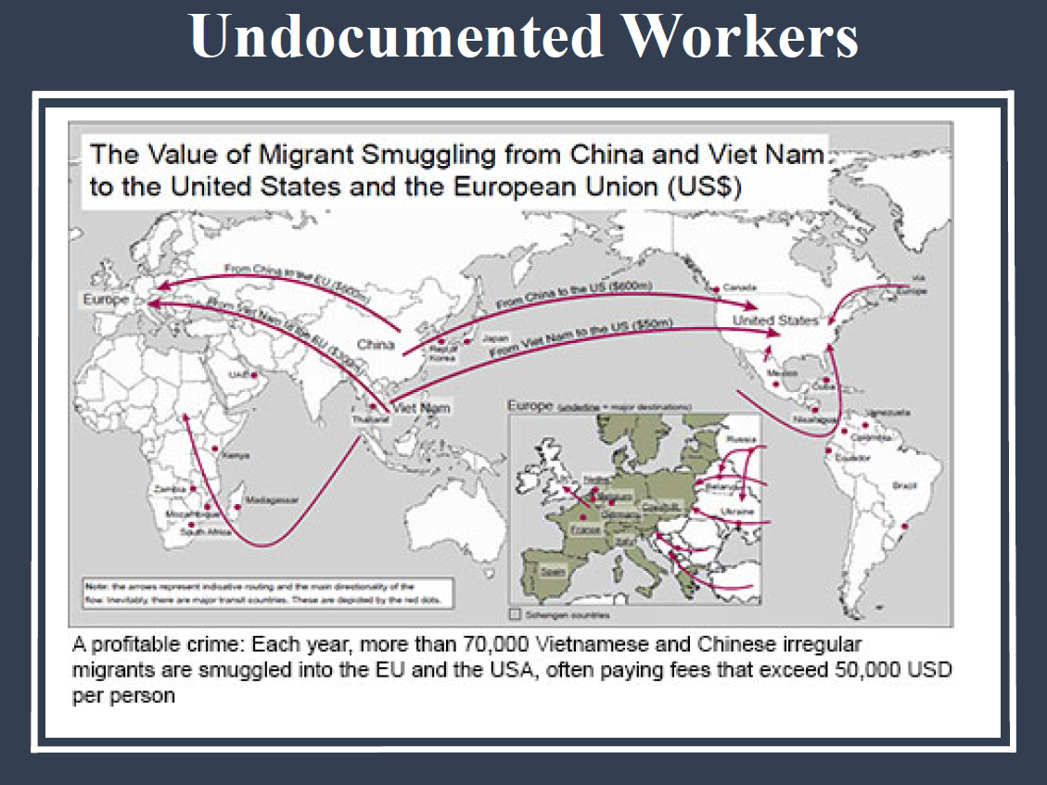

Slide 7
Myth #1: trafficking requires crossing boarders
Reality: Trafficking is About Exploitation
Human Smuggling
Human Trafficking
About
MOVEMENT
About
EXPLOITATION
Undocumented
Voluntary or Involuntary
Crime against borders
Transportation
Citizen or Undocumented
Involuntary
Crime against Person
Abuse
Notes:
Smuggling:
Undocumented
Voluntary or involuntary
Crime against borders
About transportation
Trafficking:
Citizen or undocumented
Involuntary
Crime against person
About exploitation

Slide 8
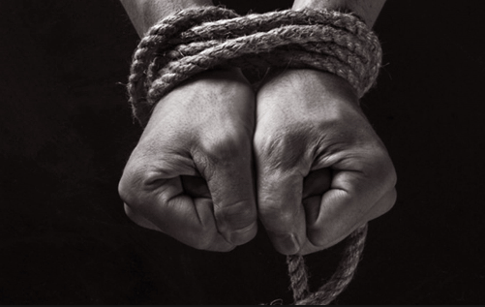
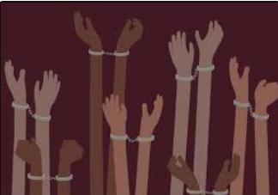
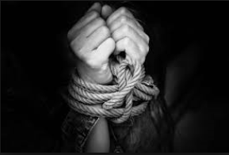

Myth #2: trafficking requires physical restraint
Reality: physical restraint is not required
Notes:
SMT

Slide 9
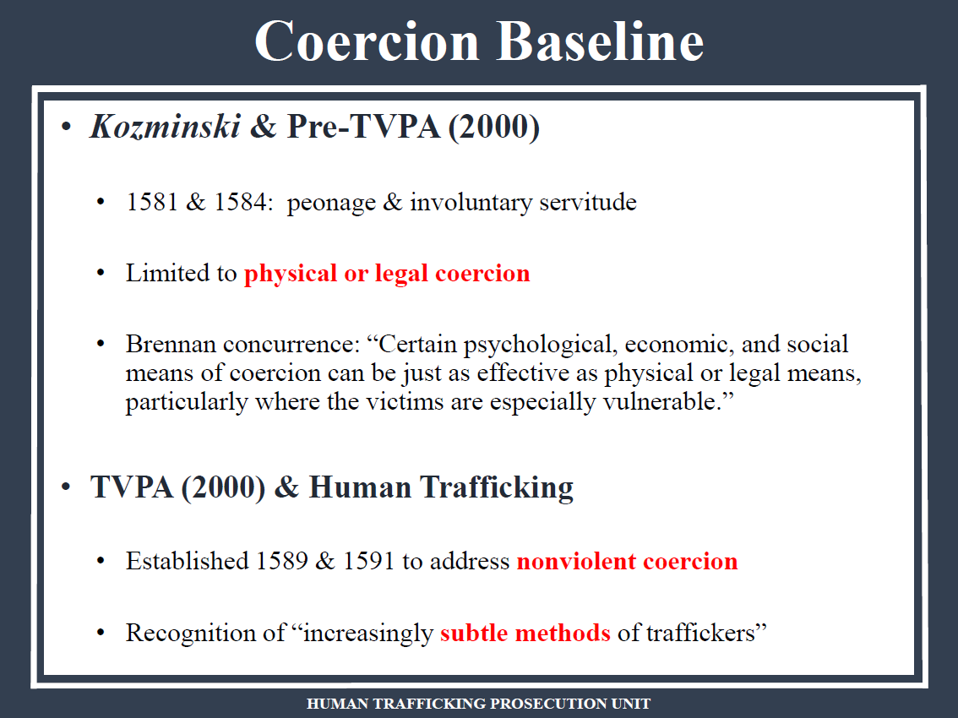

Slide 10
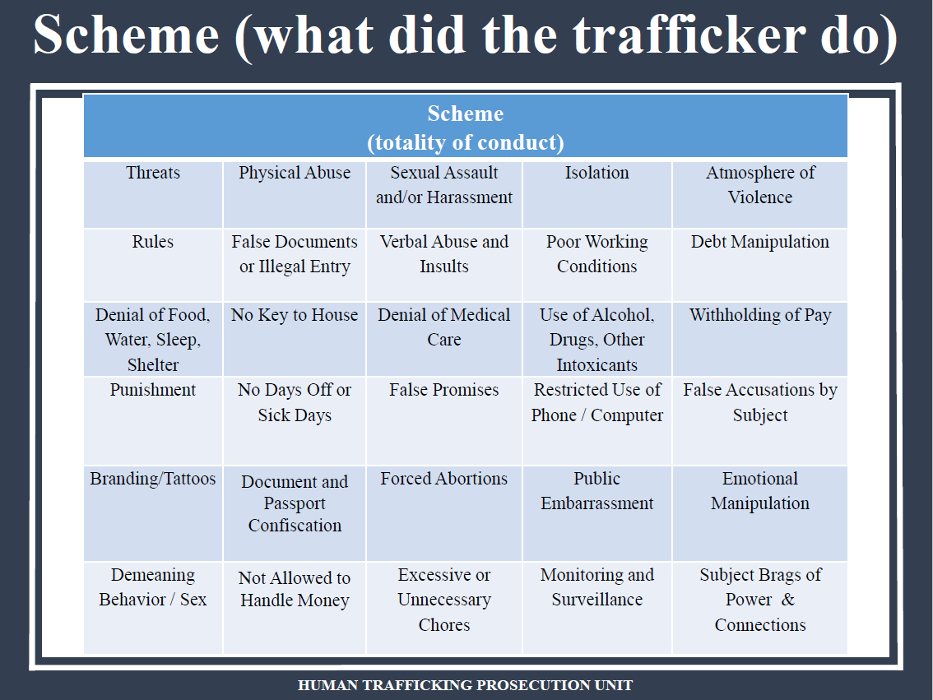

Slide 11
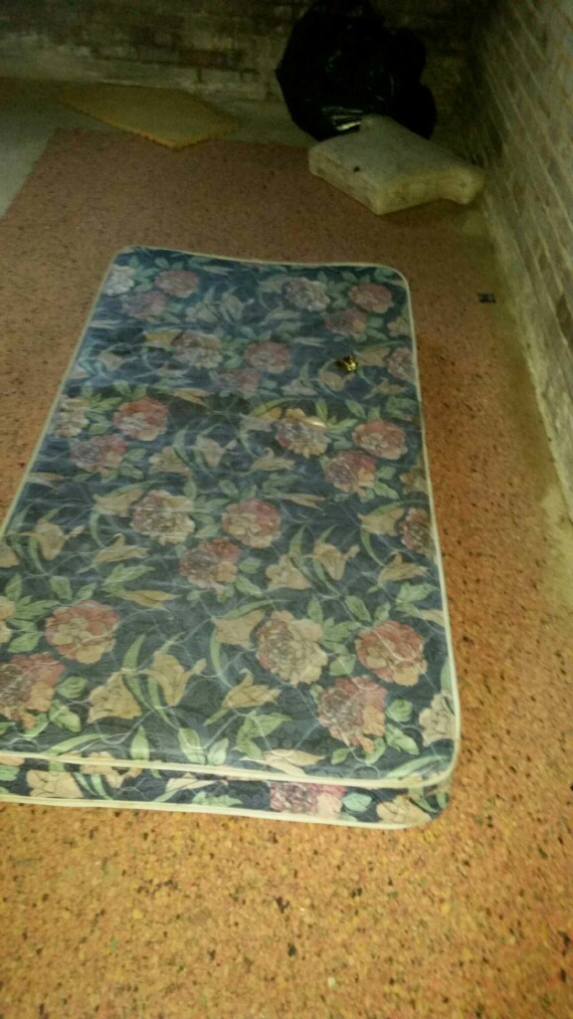
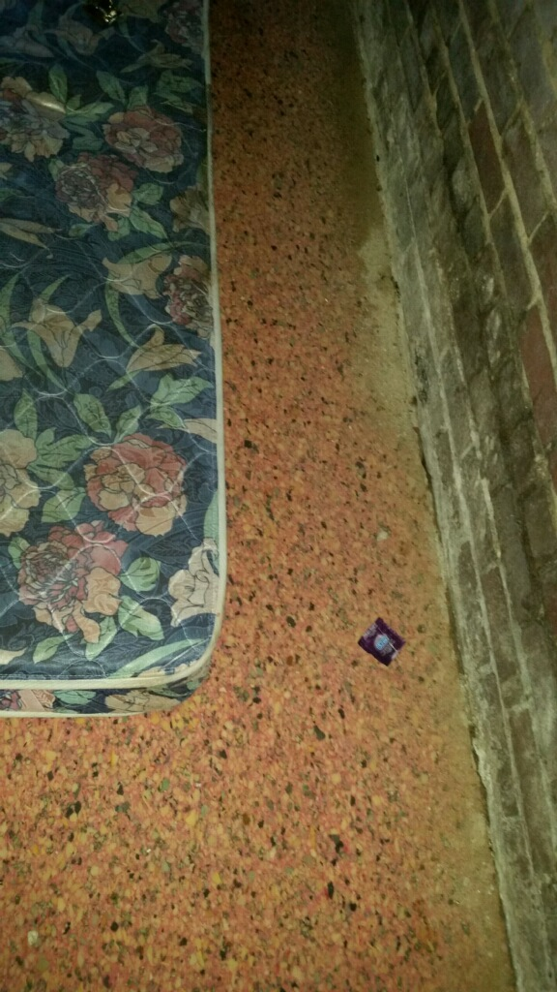

Slide 12
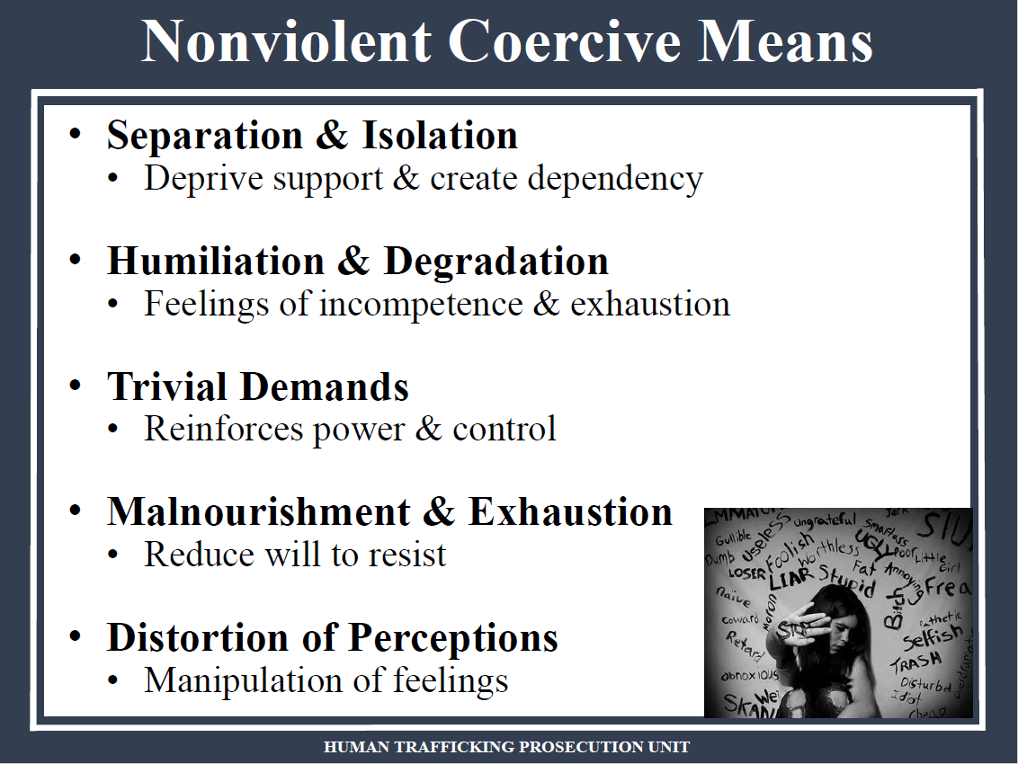

Slide 13
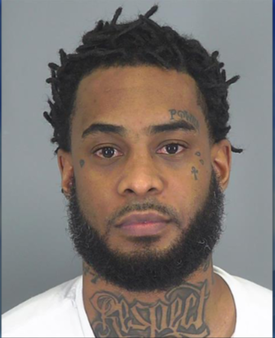


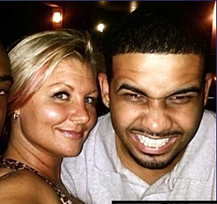

Slide 14
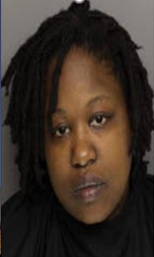
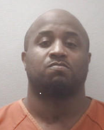
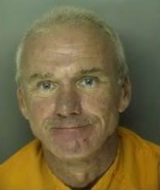
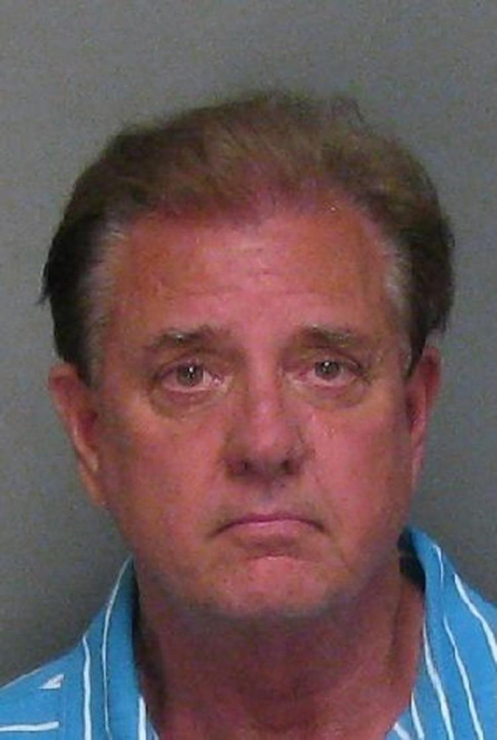
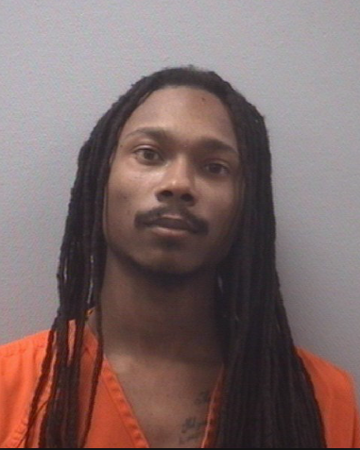
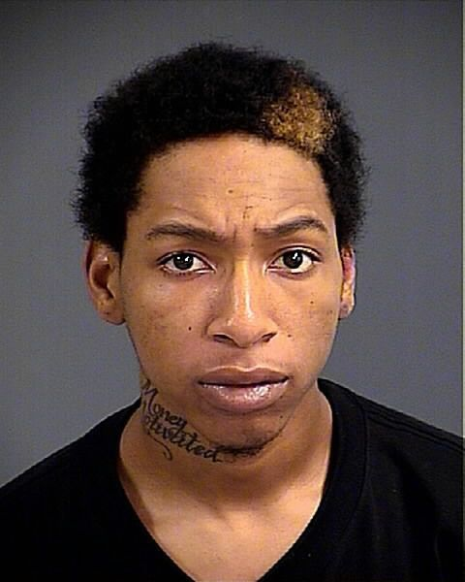
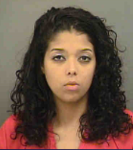
THE CRIMINAL: Who Can be guilty of human trafficking?
drivers
pimps
johns
security guards
property owners
mamas
hotel magers
madames
Notes:
150b year industry
Traffickers see markets- not state lines, county lines, etc.
Profitable. Sell coke one time. Sell a victim many times.
Which is why we’re seeing gangs, including the Bloods and the Crips in SC, shifting their biz model to HT- bc it is profitable
And I’m going to share with y9ou one of those cases we prosecuted this year

Slide 15
ANYONE WHO
Sex Trafficking
18 U.S.C. § 1591
Defendant recruited/enticed harbored/transported/provided/ obtained/maintained/advertised/ patronized/solicited the victim;
by force/fraud/ coercion*
to cause the victim to engage in a commercial sex act;
*force/fraud/coercion NOT required if the victim is a minor
Penalties: 15 to Life + mandatory restitution
Forced Labor
18 U.S.C. § 1589
Provides/obtains/benefits from the venture that provides/obtains labor/services:
By one of these four prohibited means:
Force/restraint
Threats of serious harm or restraint (to the victim or another person)
Abuse of legal process
Coercive scheme/plan/pattern
Penalties: 0 - 20, or up to Life if aggravating factors + mandatory restitution

Slide 16
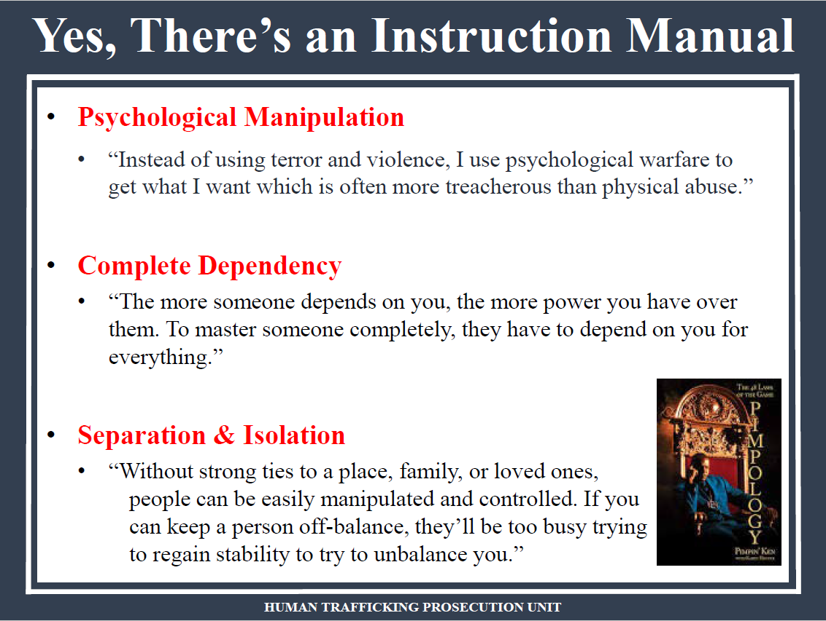

Slide 17
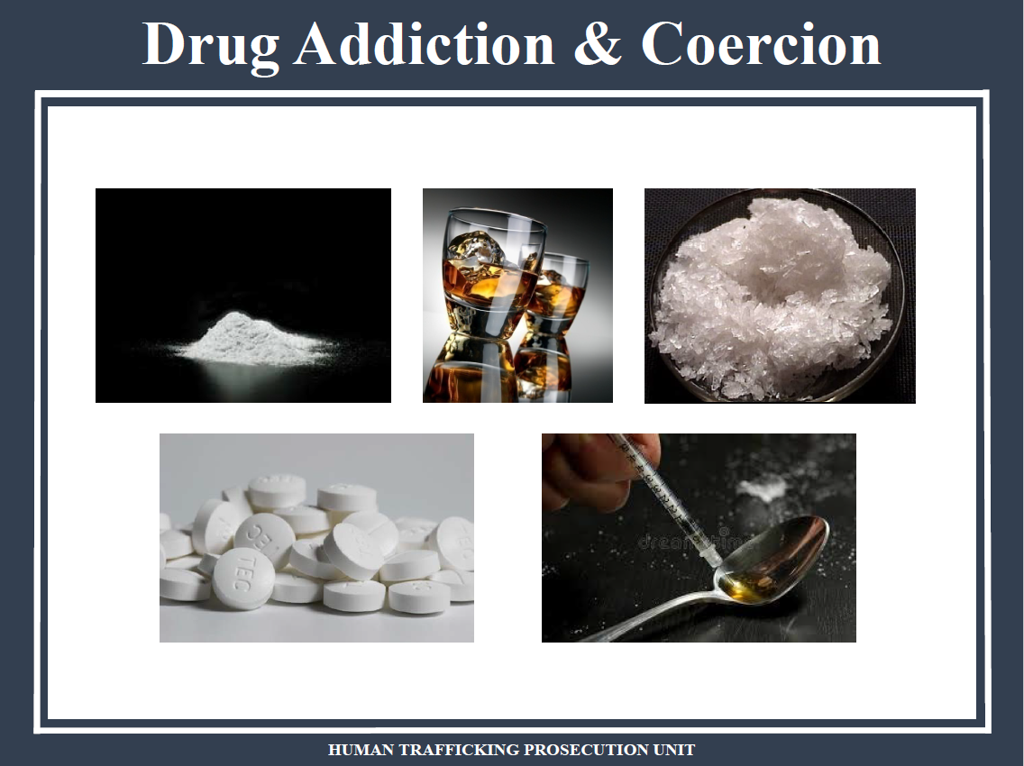

Slide 18
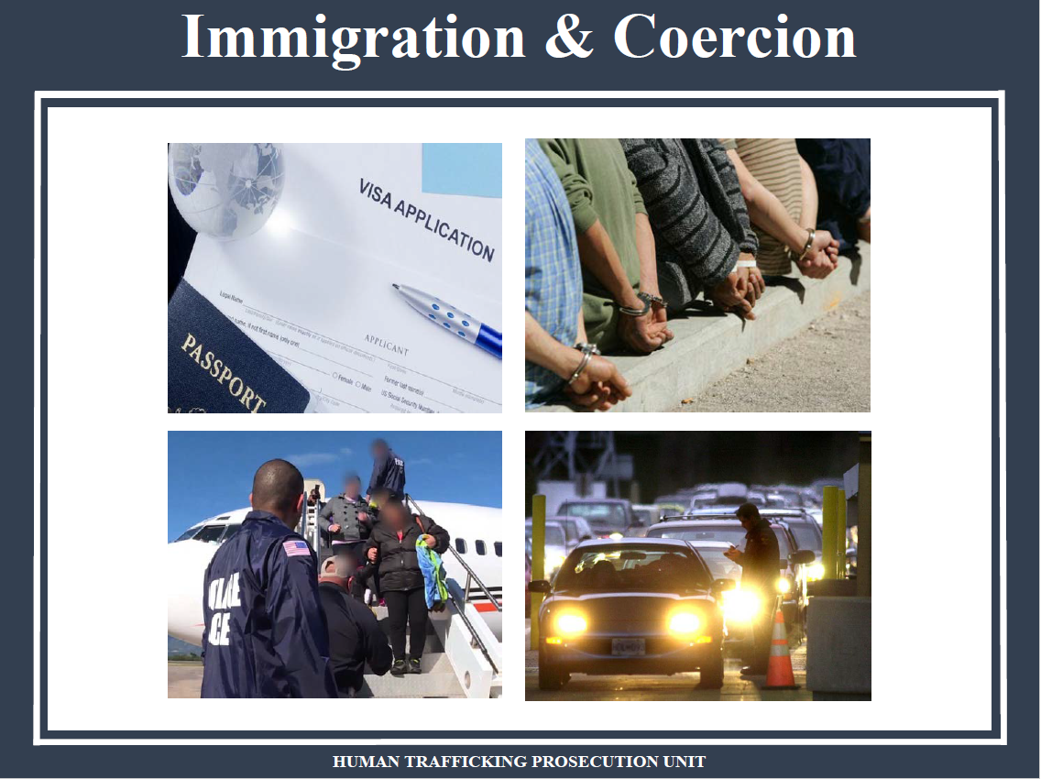

Slide 19

THE SURVIVORS: How do we know if someone is a human trafficking “victim?”
Victim or Survivor or Person
Notes:
Manipulation of Debts
Verbal Abuse and Intimidation
Demeaning and Demoralizing
Psychological Manipulation and Control
Confiscation of Documents
Onerous Living and Working Conditions
Ominous Comments
Monitoring and Surveillance
Isolation
Deception and Fraud
Withholding of Pay
Separation & Isolation: Deprive support & create dependency
Humiliation & Degradation: Feelings of incompetence & exhaustion
Trivial Demands: Reinforces power & control
Malnourishment & Exhaustion: Reduce will to resist
Distortion of Perceptions: Manipulation of feelings

Slide 20
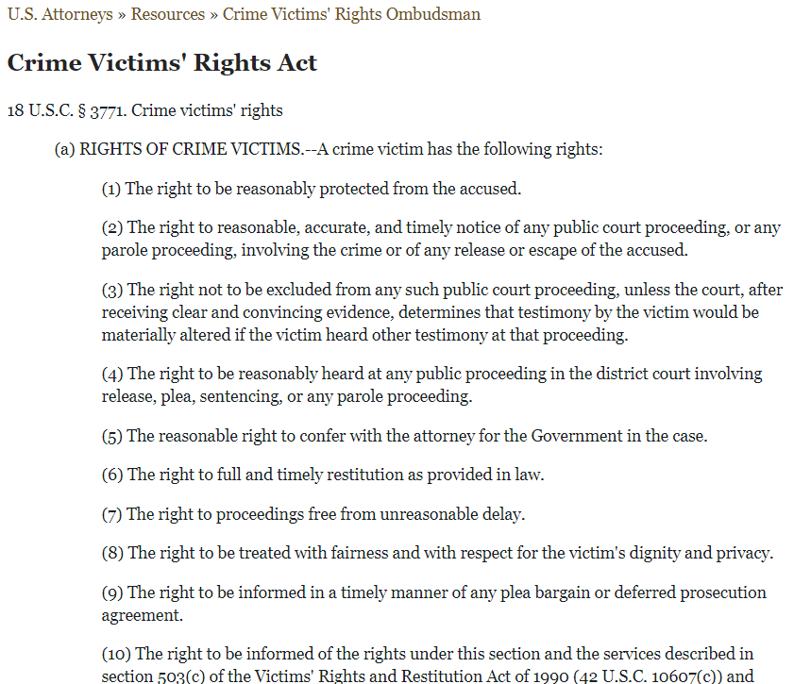
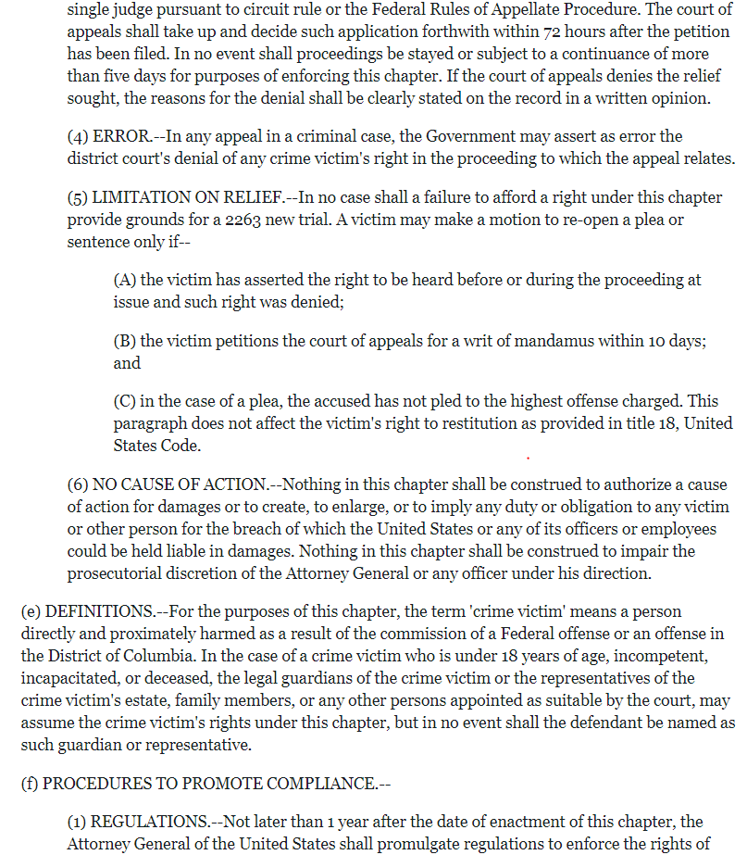
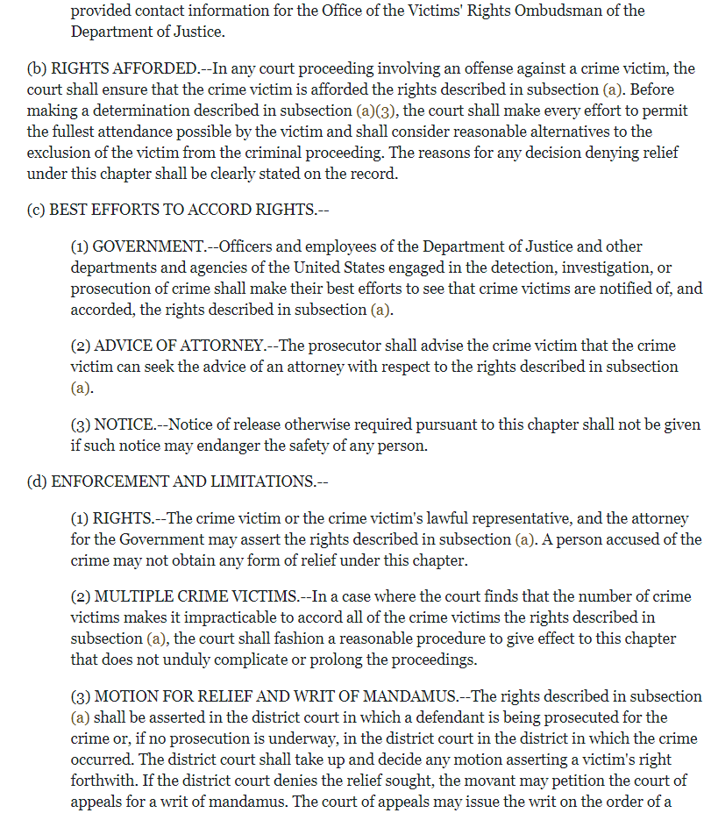
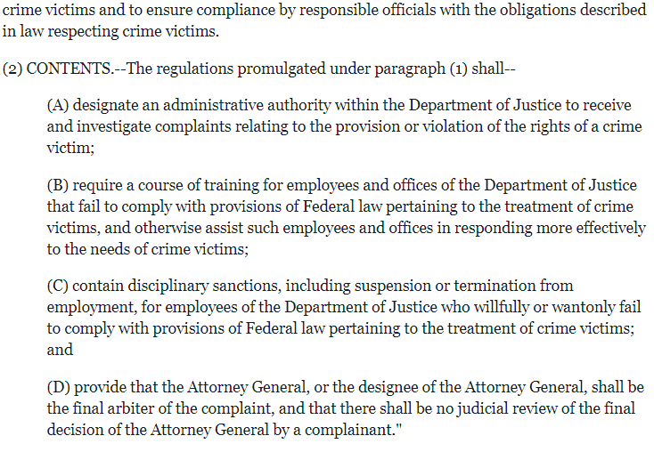
A FEDERAL CRIME VICTIM HAS THE FOLLOWING RIGHTS:
- The right to be reasonably protected from the accused.
- The right to reasonable, accurate, and timely notice of any public court proceeding, or any parole proceeding, involving the crime or of any release or escape of the accused.
- The right not to be excluded from any such public court proceeding, unless the court, after receiving clear and convincing evidence, determines that testimony by the victim would be materially altered if the victim heard other testimony at that proceeding.
- The right to be reasonably heard at any public proceeding in the district court involving release, plea, sentencing, or any parole proceeding.
- The reasonable right to confer with the attorney for the Government in the case.
- The right to full and timely restitution as provided in law.
- The right to proceedings free from unreasonable delay.
- The right to be treated with fairness and with respect for the victim's dignity and privacy.
- The right to be informed in a timely manner of any plea bargain or deferred prosecution agreement.
- The right to be informed of the rights under this section and the services described in section 503(c) of the Victims' Rights and Restitution Act of 1990 (42 U.S.C. 10607(c)) and provided contact information for the Office of the Victims' Rights Ombudsman of the Department of Justice.
Notes:
Manipulation of Debts
Verbal Abuse and Intimidation
Demeaning and Demoralizing
Psychological Manipulation and Control
Confiscation of Documents
Onerous Living and Working Conditions
Ominous Comments
Monitoring and Surveillance
Isolation
Deception and Fraud
Withholding of Pay
Separation & Isolation: Deprive support & create dependency
Humiliation & Degradation: Feelings of incompetence & exhaustion
Trivial Demands: Reinforces power & control
Malnourishment & Exhaustion: Reduce will to resist
Distortion of Perceptions: Manipulation of feelings

Slide 21
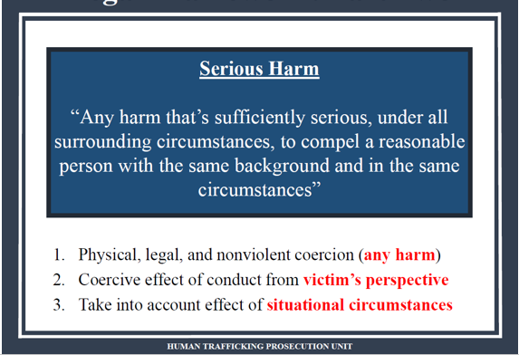

Slide 22
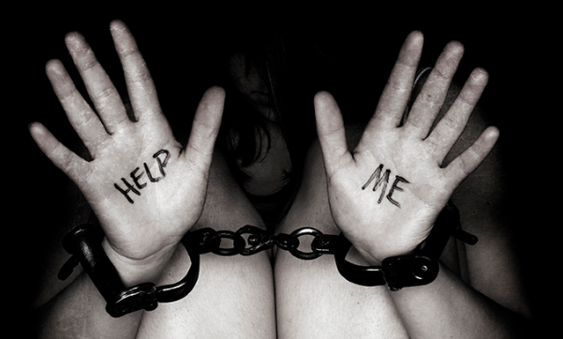
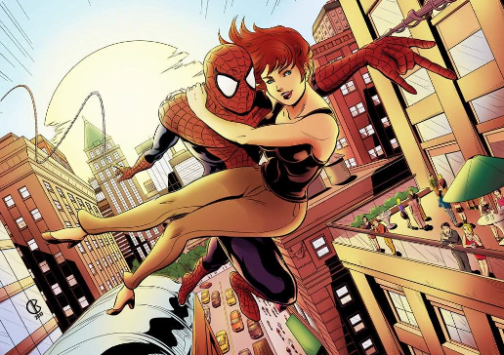
Myth #3: Victims cannot wait to be “rescued” and readily identify as victims
Notes:
SMT

Slide 23
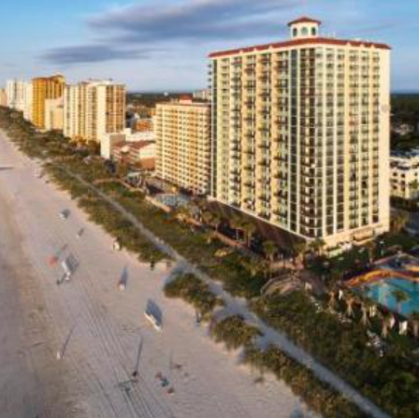
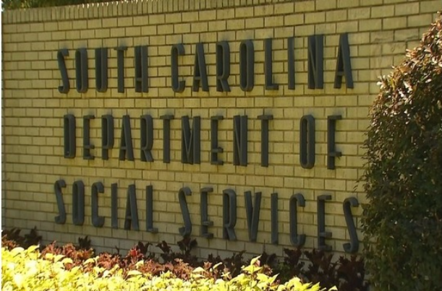
Victims rarely self-identify
Trends:
Children
Difficult backgrounds
Foreign nationals without status
The disabled
Reality: Who are the victims?
Notes:
15 to 47
Intellectually disabled to honor roll students
Philippines to Forest Acres
From families of means to children running away from the Foster system

Slide 24
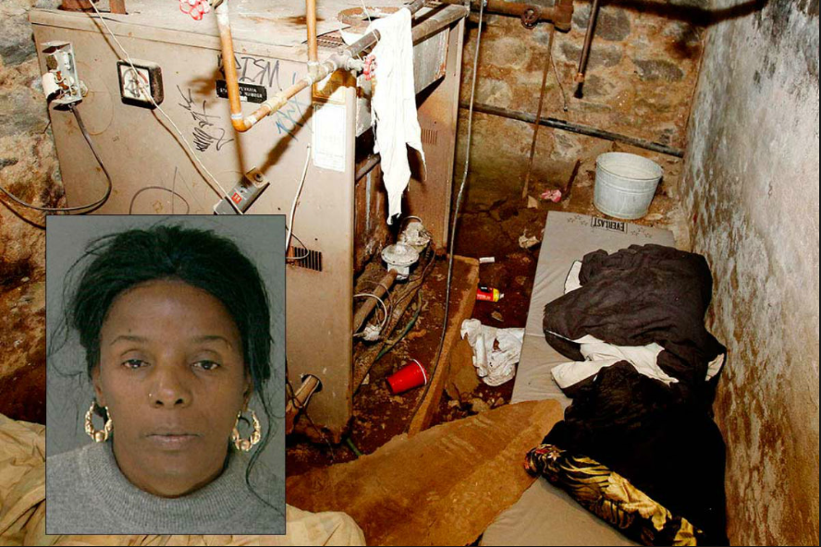
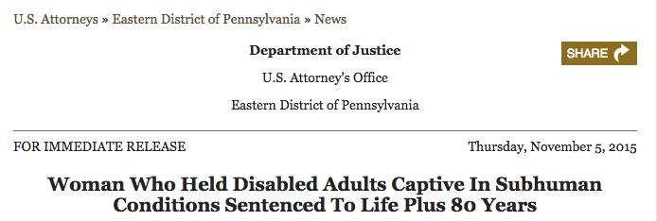
Vulnerable Victims
Notes:
15 to 47
Intellectually disabled to honor roll students
Philippines to Forest Acres
From families of means to children running away from the Foster system

Slide 25
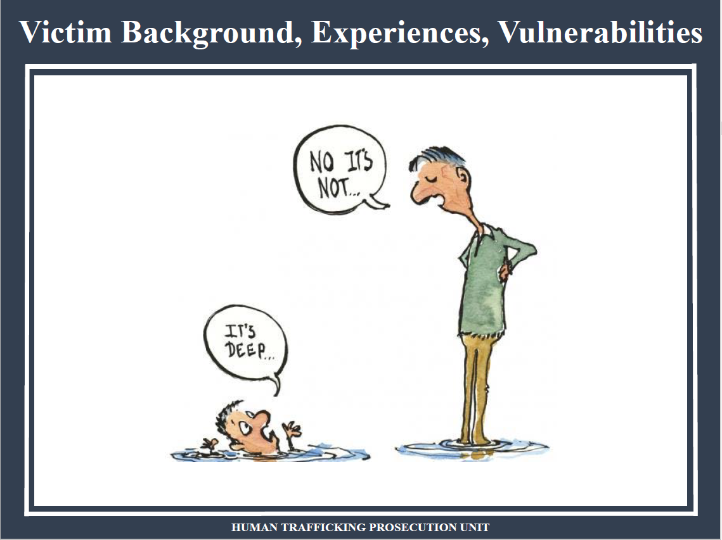

Slide 26
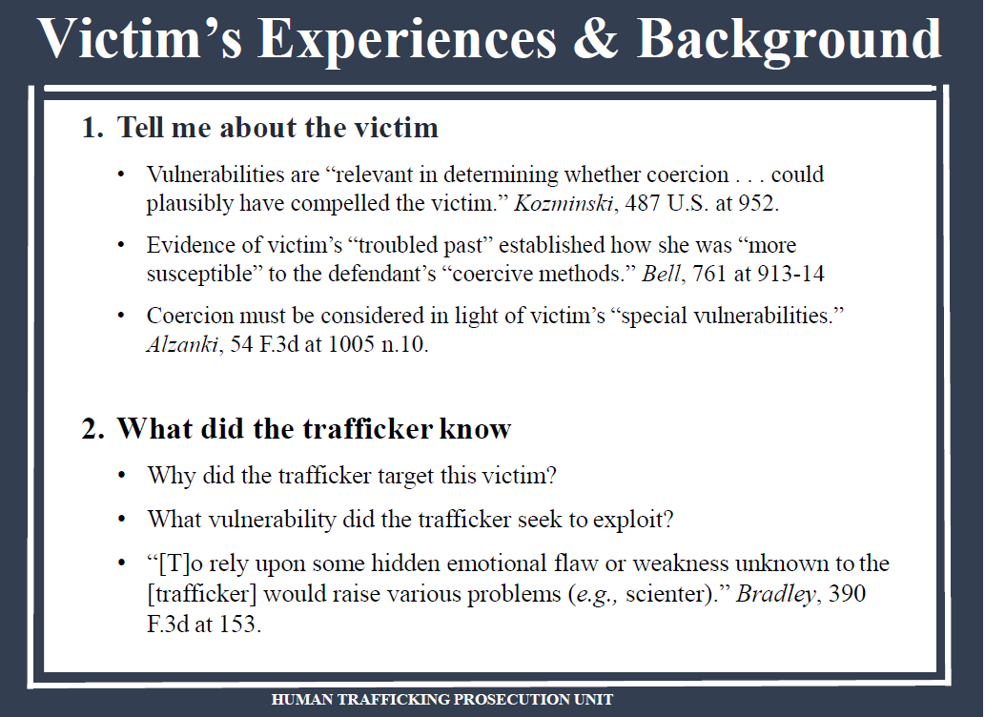

Slide 27
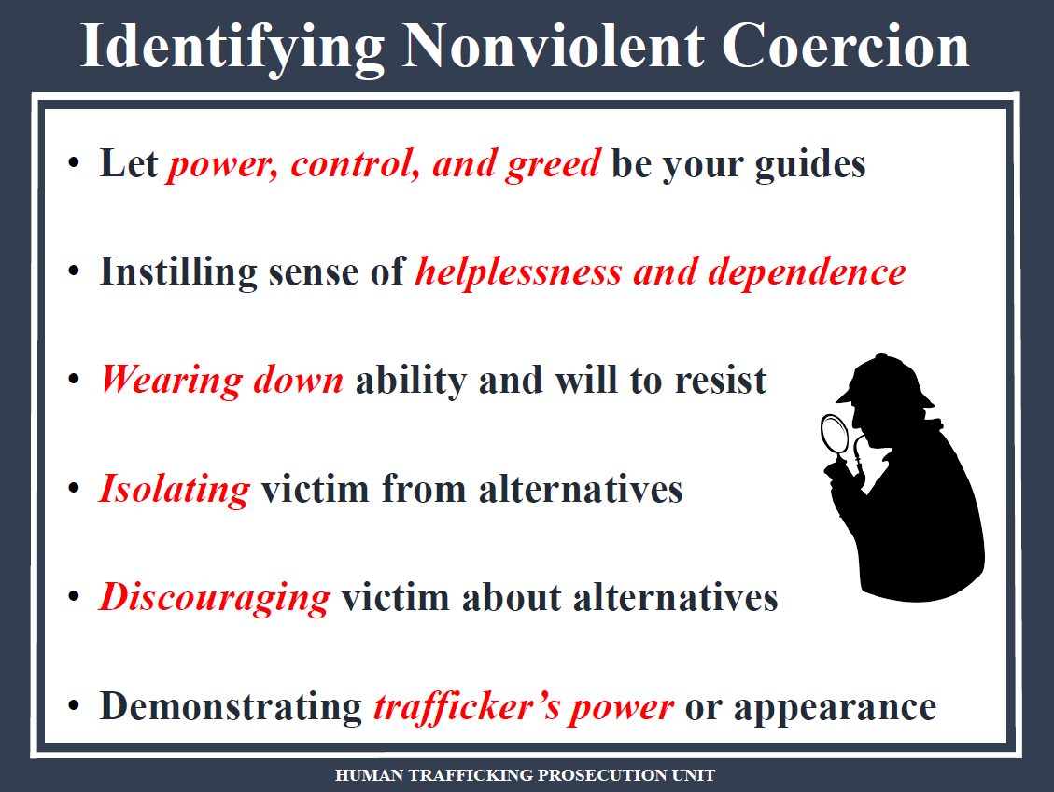

Slide 28
THE SYSTEM
Detention Hearing /Fed arrest
Appeal
Indictment
Presentence Report
ID Criminal Conduct
Complaint
Plea/Trial
Sentencing
Superseding Indictment
State Action
INVESTIGATION
Testimony
Victim Impact Statement
Restitution Request Forfeiture
Testimony
GRAND JURY
(Testimony?)
INTERVIEWS
Victim 1 ID
VWC
Potentially ID more Victims
VWC

Slide 29
THE SYSTEM
ID Criminal Conduct
State Action
INVESTIGATION
INTERVIEWS
Victim 1 ID
VWC

Slide 30
THE SYSTEM
Detention Hearing /Fed arrest
Indictment
ID Criminal Conduct
Complaint
Superseding Indictment
State Action
INVESTIGATION
GRAND JURY
(Testimony?)
INTERVIEWS
Victim 1 ID
VWC
Potentially ID more Victims
VWC

Slide 31
THE SYSTEM
Detention Hearing /Fed arrest
Indictment
ID Criminal Conduct
Complaint
Plea/Trial
Superseding Indictment
State Action
INVESTIGATION
Testimony
GRAND JURY
(Testimony?)
INTERVIEWS
Victim 1 ID
VWC
Potentially ID more Victims
VWC

Slide 32
THE SYSTEM
Detention Hearing /Fed arrest
Appeal
Indictment
Presentence Report
ID Criminal Conduct
Complaint
Plea/Trial
Sentencing
Superseding Indictment
State Action
INVESTIGATION
Testimony
Victim Impact Statement
Restitution Request Forfeiture
Testimony
GRAND JURY
(Testimony?)
INTERVIEWS
Victim 1 ID
VWC
Potentially ID more Victims
VWC

Slide 33
THE SYSTEM
Detention Hearing /Fed arrest
Appeal
Indictment
Presentence Report
ID Criminal Conduct
Complaint
Plea/Trial
Sentencing
Superseding Indictment
State Action
INVESTIGATION
Testimony
Victim Impact Statement
Restitution Request Forfeiture
Testimony
GRAND JURY
(Testimony?)
INTERVIEWS
Victim 1 ID
VWC
Potentially ID more Victims
VWC

Slide 34
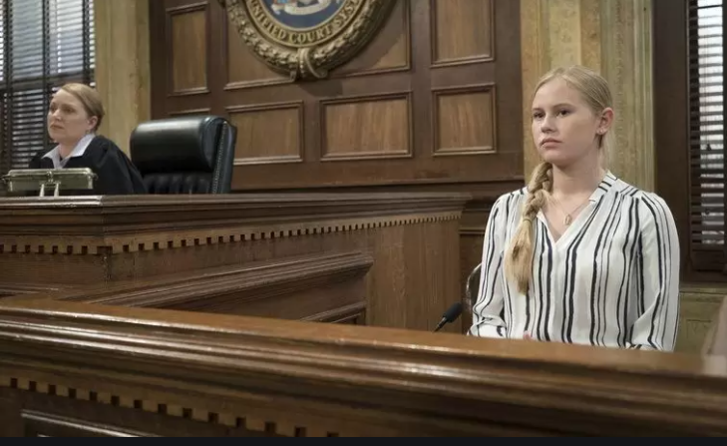

Notes:
SMT

Slide 35
THE SYSTEM
Detention Hearing /Fed arrest
Appeal
Indictment
Presentence Report
ID Criminal Conduct
Complaint
Plea/Trial
Sentencing
Superseding Indictment
State Action
INVESTIGATION
Testimony
Victim Impact Statement
Restitution Request Forfeiture
Testimony
GRAND JURY
(Testimony?)
INTERVIEWS
Victim 1 ID
VWC
Potentially ID more Victims
VWC

Slide 36
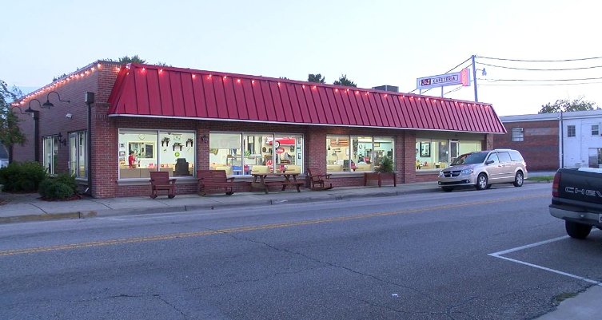
1. Forced Labor § 1589
United States v. Bobby Paul Edwards
Notes:
SMT

Slide 37
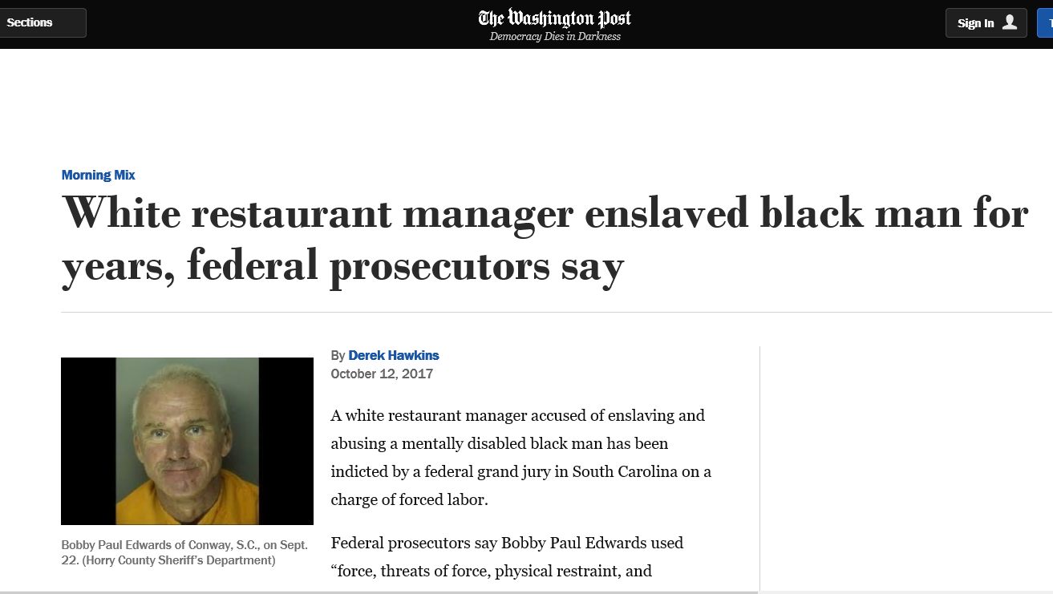
1. Forced Labor § 1589
United States v. Bobby Paul Edwards
Notes:
SMT

Slide 38
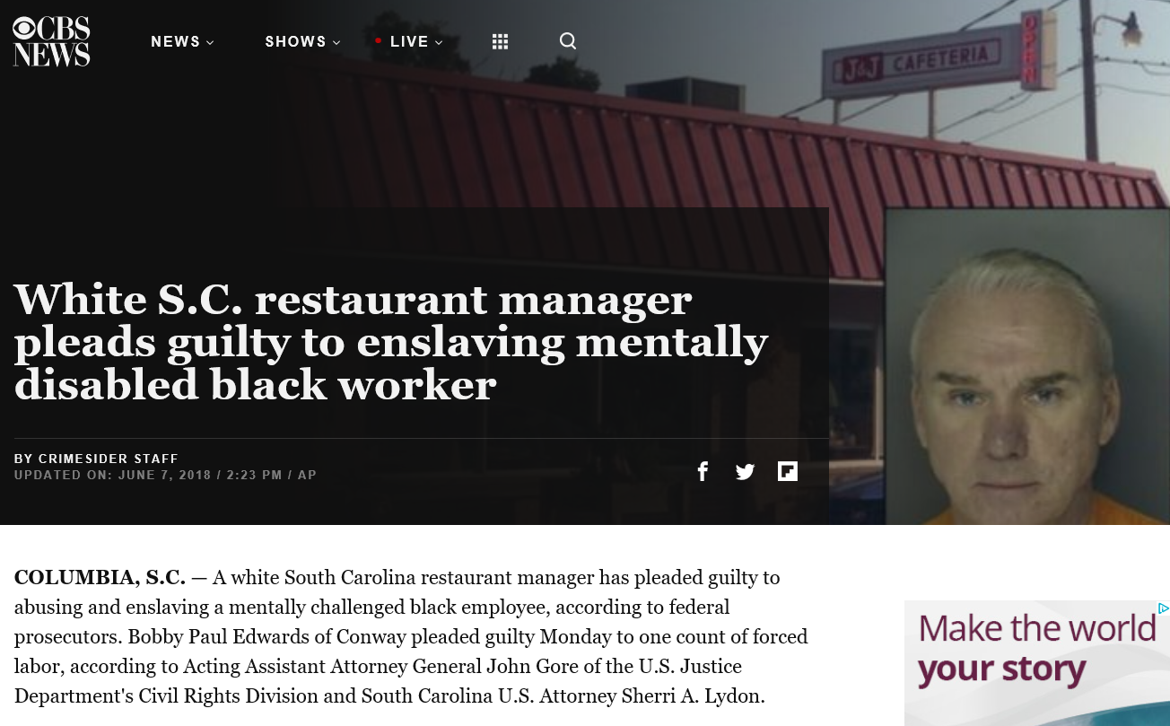
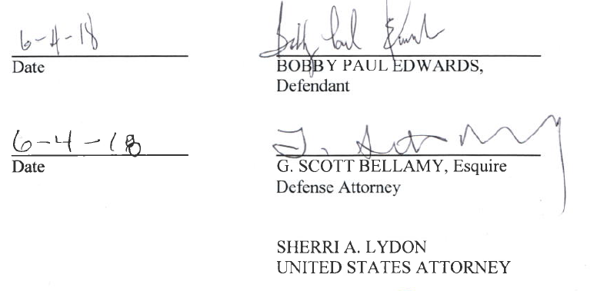
Two Major Categories
Notes:
SMT

Slide 39
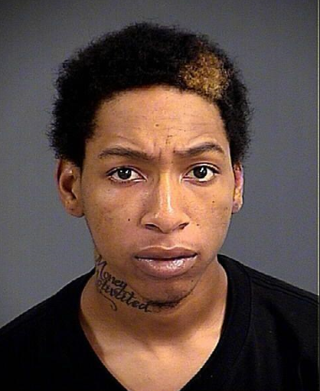
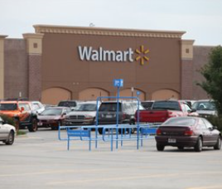

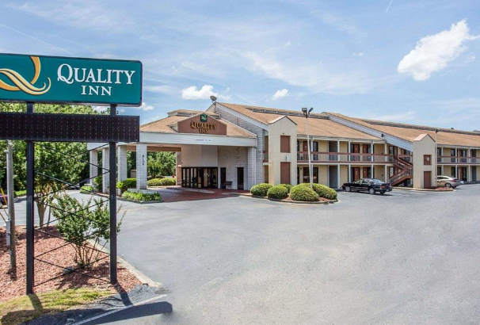
2. Sex Trafficking§ 1591
United States v. Damon Jackson, et. al.
Notes:
SMT

Slide 40
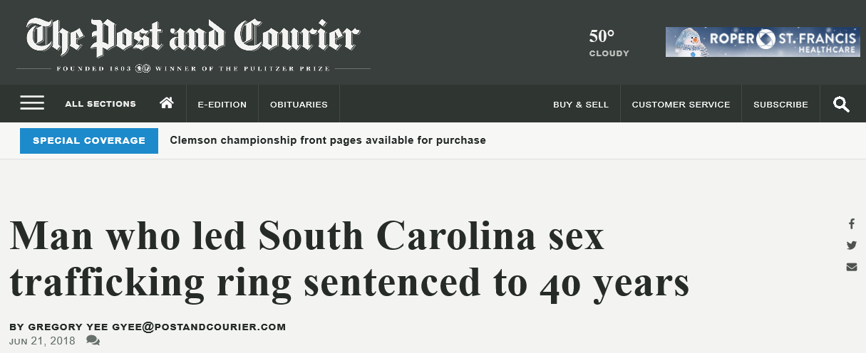
2. Sex Trafficking§ 1591
United States v. Damon Jackson, et. al.
Damon Jackson (“D”, “Daddy Frost”) of Columbia - 40 years.
Bakari McMillan (“Bizzle”) age 25, of Columbia - 40 years.
Corey Miller (“Clow”, “C”, “OG P”) age 44, of Orangeburg - 20 years.
Tremel Black (“Sincere”, “Sin” “New York”) age 33, of New York, - 25 years.
Robert Black (“Kareem Banks”, “Nino Black”, “Black”) age 47, of New York - 20 years.
Desmond Singletary (“Six”) age 32, of Florence - 15 years.
Kerry Taylor (“KJ”) age 23, of Columbia - 11 years.
Ryan Turner (“Gotti”, “Qweezy”) age 25, of Columbia - 10 years.
Da’Shun Curry (“Dae Dae”) age 25, of Columbia- 9 years.
Howard Parker (“Poppa”) age 25, of Columbia - 6 years.
Collectively sentenced to 166 years imprisonment

Slide 41
Questions?
Jamie Lea Schoen
Assistant United States Attorney
District of South Carolina

