Slide 1

Fire Reports
A Quick Primer on Understanding Them

Slide 2
Objectives
Understand the purpose of fire reports
Understand the National Fire Incident Reporting System (NFIRS)
Basic NFIRS Rules
Overview of the modules
Know NFPA 921’s position on Fire Reports

Slide 3
Source of Information
America Burning, The Report of the National Commission on Fire Prevention and Control. May 1973. National Commission on Fire Prevention and Control.
Introduction to NFIRS 5.0, Intro to NFIRS 5.0 Instructor Guide, 3 Edition, 4th Printing, May 2013. United States Fire Administration, Federal Emergency Agency.
NFIRS 5.0 Self-Study Module: NFIRS-8, United States Fire Administration, Federal Emergency Agency.
NFPA 921, Guide for Fire and Esxplosion Investigations, 2017 Edition, National Fire Protection Association.

Slide 4
The Purpose of Fire Reports
To document an incident the fire department responded to. The information documented would include:
Date/Time
Address
Type of incident
Actions taken
Injuries/fatalities
Losses
To provide leaders with data that will allow them to improve response times and tactics

Slide 5
The Purpose of Fire Reports
To provide data to show trends in responses to industry involving products
To provide data to law makers showing incident trends that allow for policies and programs to reduce the loss of life and property

Slide 6
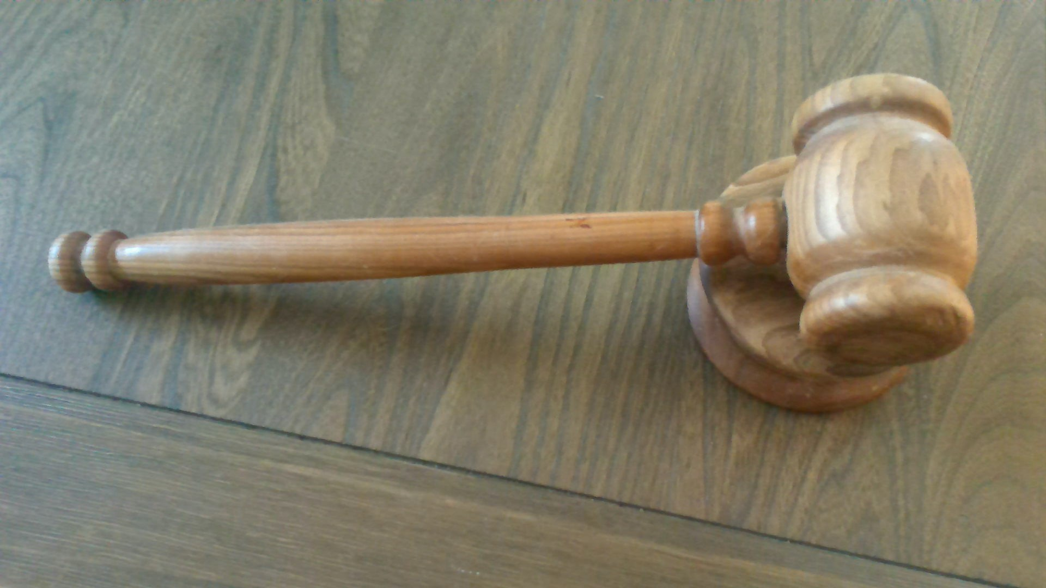
Why Should You Care?
Not all fire reports are uniform
You need to know if you got the entire report. Just because you don’t have all the modules doesn’t mean the report is not complete.
To understand the data fields and why they may not match the narrative or why some fields are blank.
Additional reports may exist from other fire departments that may have responded to the call that may help provide a clearer picture.
Many cases where the report is completed by the firefighter with the least experience in the fire service.
NFIRS and NFPA rules/codes can be confusing to both fire departments and attorneys

Slide 7
The Development of Fire Reports
Limited data was available regarding fires. Some information was obtained from the National Fire Protection Association (NFPA) through their own research.
In 1972 President Nixon commissioned a report titled America Burning. One of the recommendations the report called for was the development of a nationwide method of collecting data used to study the fire problem and find solutions to combat them.
This brought about the National Fire Incident Reporting System (NFIRS)

Slide 8
NFIRS
Program under the control of the United States Fire Administration (USFA)
Allows for uniformed reporting
Codes and rules and developed with the consensus of various stakeholders
The program is voluntary unless mandated by the state. Check with your state.
States control the data
The systems has a basic module with additional 10 modules
Some data fields in the modules are mandatory
Data fields are drop down. The number codes are set by USFA. However, with commercial software the descriptions may differ
Organizations call also add one-plus codes
Reports can be updated when additional information is available

Slide 9
NFIRS Modules
Module 1(Basic). Completed for all incidents
Module 2 (Fire). Completed for all fires. If a wildland fire, then Module 8 may be used.
Module 3 (Structure Fire).Completed for all building fires
Module 4 (Civilian Casualty). Completed when non fire department personnel are injured or killed at a fire
Module 5 (Firefighter Casualty). Completed for any incident that a firefighter is injured or killed
Module 6 (EMS). Optional form used when medical care is provided. This may not be NEMSIS compliant
Module 7 (HAZMAT). Optional form. Used when hazardous materials are involved in an incident.

Slide 10
NFIRS Modules (continued)
Module 8 (Wildland Fire). An optional form that may be used in lieu of Module 2 involving wildland fires
Module 9 (Apparatus). An optional form that shows which units were involved with the incident
Module 10 (Personnel). An optional form. Shows the personnel on scene and what actions they preform. Note Module 9 and 10 should not be used for the same incident.
Module 11 (Arson). An optional form. Used if the fire is under investigation, the fire was intentional or if a juvenile firesetter is involved.
NFIRS-1S Supplemental. An optional form for any additional information

Slide 11
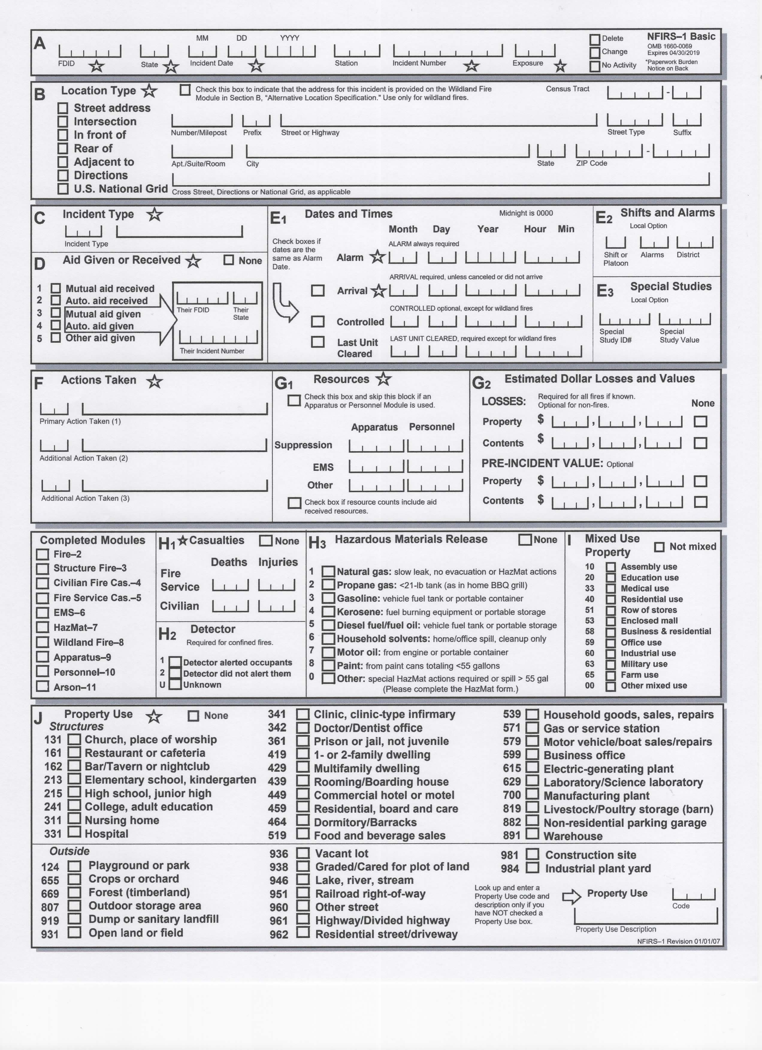
NFIRS Basic Rules
The jurisdiction is required to complete all required modules as appropriate
Departments providing aid are required to complete a modified report
All fields that have stars are mandatory
A separate (modified) report is required for each exposure
Reports should be quality check prior to issue and/or submission.
Reports are required to be submitted to the database monthly.

Slide 12
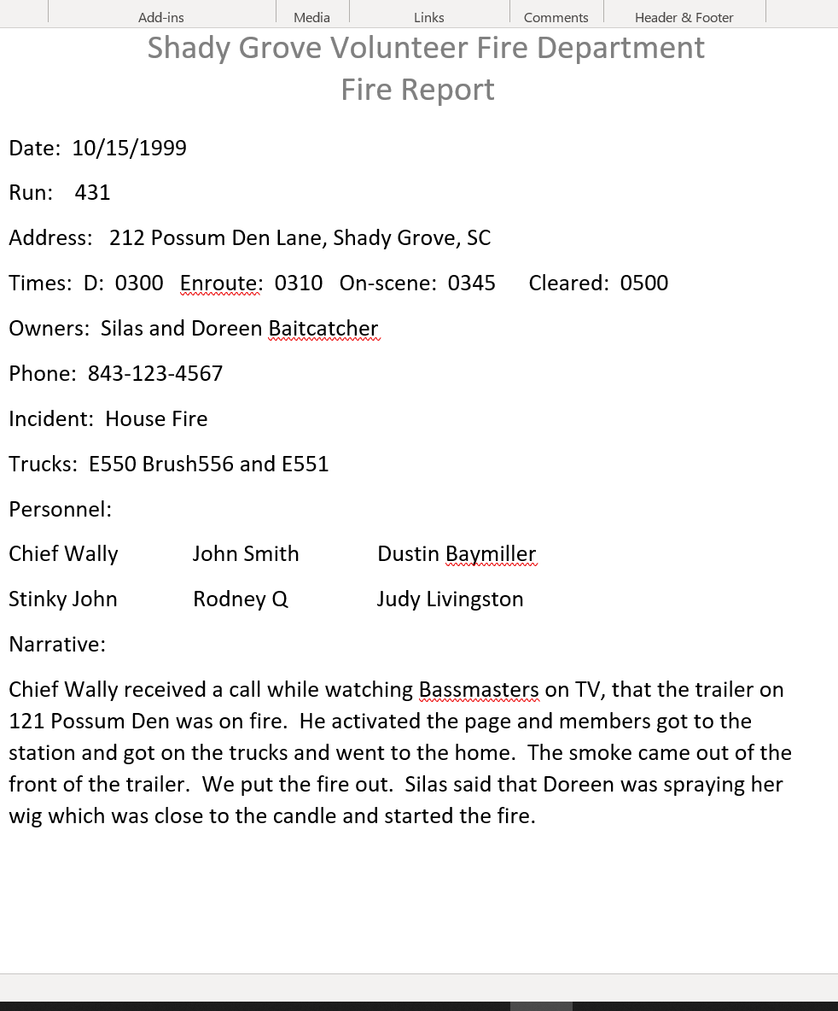
Not All Reports Are Uniform
NFIRS is voluntary
States may mandate the format to use
Some departments use commercial reporting that software that will allow the organization to create a plain text report while sending the data to the database

Slide 13
What You May Not Get in a Report
An official ruling on the cause of a fire (Origin and Cause Report)
911 CAD notes or recordings
Photos
Lab Reports
Autopsies Reports
Sketches
Notes
Witness statements
Any other work product the department created in relation to the incident

Slide 14
What Should an Attorney Check With a Report?
Were all modules received?
Does the address and occupants match?
How many of the data fields are completed.
Do the codes in the data fields match the narrative
If there are multiple narratives are there any contradictions?
If mutual aid (assistance from neighboring department) was used are they in the case file
Does the report give any indication of malice
If they are any discrepancies, they should be resolved with the fire department as soon as possible. If the report is amended a new copy should be provided

Slide 15
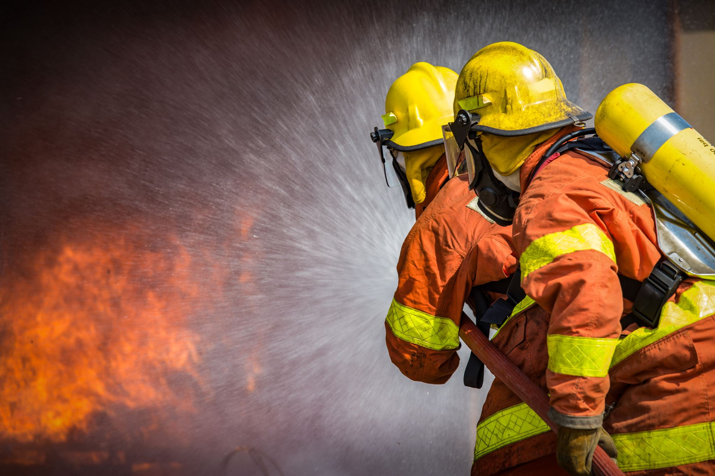
Module 1
Basic Module

Slide 16
Module 1(Basic)
This module is completed for incidents. In some incidents this may be the only module completed.
Coding of the incident may indicate if additional modules are required.
Information in the mandatory fields must be conform to NFIRS rules, or the system will not validate the report. This does not mean that the report is accurate.

Slide 17
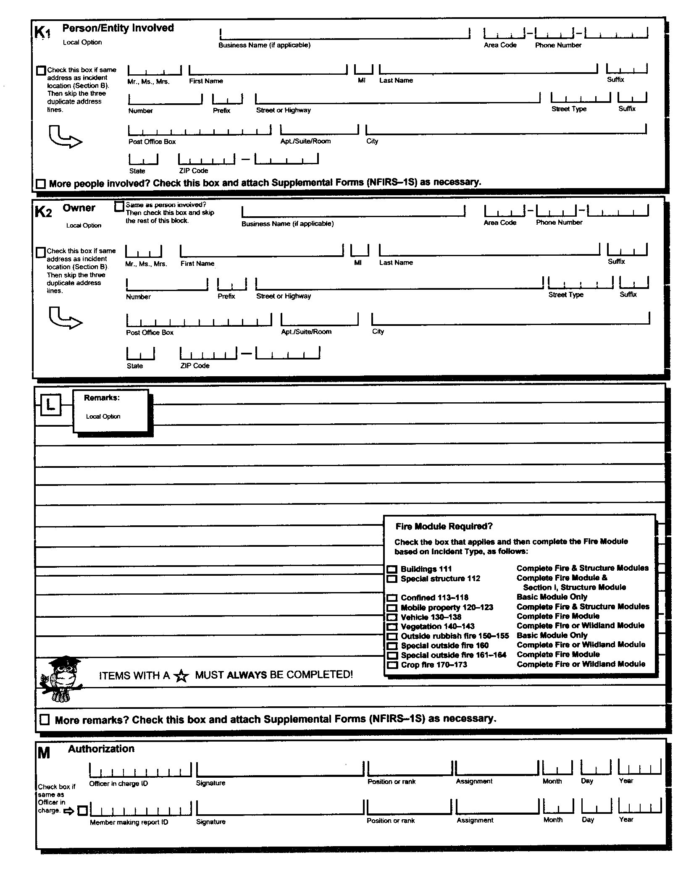
Module I Basic Report
Notes
The form shown is the form created by USFA. Commercial forms may vary in appearance
All areas that have a
Is a mandatory data fields that must be completed
This report is the bare minimum that an attorney should expect.

Slide 18
Module 1 Section A
FDID: This is the identification number of the fire department. This is issued by the state
State: The state abbreviation assigned by the United States Postal Service
Incident Date: The date the incident occuried
Note: This may not be the same as the date of loss.
Station: This is the fire station that is completing the report. There may be other stations that respond to this call
Incident number: This administrative number assigned by the department. Attorneys should use this number for FOIA request instead of a claim or case number.
Exposure: This shows the number is buildings or vehicles that burned in this incident. All reports start as 000. There is no order for the additional reports.
Delete, Change or No Activity. Used if there is a change in report. Often this is not used, and some commercial software will not allow for this to be entered.

Slide 19
Module 1 Section A Attorney Notes
Try to use the incident number and the date. This is often how departments will try to fine the report. Attorney case numbers and loss claim numbers do not help the department in locating the report.
Exposure numbers: If no other property was burned. The exposure number is 000.
Example: A house was involved in a fire. The flames ignited the car in the driveway. There will be two reports. Exposure 000 will by for the house and 001 will be for the car. This also applies if the fire crosses property lines.
Exposure reports will share the same incident number.
For apartments with no firewall, then only one report is completed for the entire building.

Slide 20
Module 1 Section B Address

Slide 21
Module 1 Address Attorney Notes
Address should be verified. However, with CAD systems, the wrong address (i.e. house next door) may be used. If the department has no address, then the CAD report may need to be request.
With wildland fires the street address may be only reference point and not the actual location.
With many commercial systems, an attorney may request a record search to see how many times the fire department responded to that location. This is beneficial involving cases or insurance fraud or domestic violence.

Slide 22
Module 1 Section C Incident Type
This is a drop down that contains a 3-digit number and description. The number is assigned by USFA and cannot be changed. However, some commercial software will allow a description change
Codes range from 100 to 900. The lower the number to more severe.
The incident is what is found on scene, not what the FD was called for
Departments can create plus 1 code to further define the incident

Slide 23
Module 1 Major Incident Code Group
Fire
Overpressure Repture, Explosion, Overheat (No Ensuing Fire)
Rescue & Emergency Medical Service (EMS) Incidents
Hazardous Condition (No Fire)
Service Call
Good Intent Call
False Alarm and False Call
Severe Weather and Natural Disaster
Special Incident Type
100
200
300
400
500
600
700
800
900

Slide 24
Module 1 Incident Type Attorney Notes
Within each major code group there are sub-categories.
If the incident is a 4-digit number. This is a Plus One Code.
If there are multiple incident types at a location, then the lowest number is used. Additional information should be found in the narrative a possibly in additional modules.
For exposure reports the incident type may differ from they may report.
Example: The house fire exposure 000 would have the incident number 111 Structure fire. The vehicle 001 would be 131 Passenger vehicle fire.

Slide 25
NFIRS Module 1 Incident Types Attorney Notes
Beware that sometimes departments will use a double zero (00) code in order to bypass the requirement of completing additional modules. A common example is A department responds to a residential fire. The incident code they may use is 100 “Fire Other” instead of the proper code 111 “Structure Fire”. By using 100, the only must complete Module 2 (Fire) and not complete Module 3 (Structure Fire).

Slide 26
Module 1 Section D Aid Given or Received
This list another fire department that either assistance will be given or received.
The other department’s FDID is listed along with the state and their incident number
The none box is check if the department completing the report is the only department on the scene.

Slide 27
Module 1 Section D Attorney Notes
Key things to remember for this section
Mutual Aid Received. The Department that is the responsible for that jurisdiction called for and received assistance from another department
Auto Aid Received. Jurisdictions have an agreement where departments would send units automatically for an incident
Mutual Aid Given. The department completing the report was asked and aided another fire department
Auto Aid Given. The department completing the report automatically provided aid to another fire department.
Other Aid Given. This is checked when there is an area that is not under clear jurisdiction. An example of this is a body of water such as a lake or river.

Slide 28
Module 1 Section D Attorney Notes
Regarding which department does the full report. All other departments will complete a modified report. It is the department that has jurisdiction, not the department that first arrived or has command.
If no department has jurisdiction, then each fire department does a completed report.
If the department that aid was given or received is not given in the narrative, then as the department where the report was received from.
USFA software only allows for one department to be added. Commercial systems will allow multiple departments to be added. They may or may not appear on the printed report.
When requesting mutual aid reports, use their incident number in Section D.

Slide 29
Module 1 Section E1 Dates and Times
All times are in military time
Alarm is when the department received the call from the dispatcher not when the 911 call came in
Arrival is the first unit on scene
Controlled is used when the fire was brought under control. For wildland fires this is a mandatory field
Last Unit Cleared is filled when the final unit departs from the incident

Slide 30
Module 1 Section E1 Attorney Notes
Commercial software has the capability to “push” the times in these data fields through the CAD. USFA software has no CAD interface.
If a unit stages because of security or safety concerns, under NFIRS rules the arrival time is when they stage.
Unlike the Uniform Crime Report (UCR) once the fire department clears the scene, the incident is closed. If they must return, then a new incident number is created. This also means a new report.

Slide 31
Module 1 Section G2 Estimated Dollar Losses and Values

Slide 32
Module 1 Section G2 Attorney Notes
These are estimates only. It is only for research. Firefighters are not claim adjusters and should never be used in settlements
Losses and estimates are for the entire property, not just for one room. Exposure reports should also have estimates.
Mutual Aid reports will show estimates and losses as zero, because it is a modified report
Many times, firefighters will put none because they believe that they be held to these numbers
Some property owners believe that these are the numbers that they are entitled to in any possible settlement. As such, they become upset if they think the estimate or the settlement is too low.

Slide 33
Module 1 Completed Modules
This section shows modules on the basic report that have completed.
Boxes are checked to show completed reports
This is automatically filled in as modules are completed. There are times completed reports are not checked. Do not use this part to determine if other modules were completed.

Slide 34
Module 1 Section H1 Casualties
This list injuries and deaths for both Fire Service and Civilians
Injuries and deaths for Civilians are listed only for fires Codes 100 only. Non-fire relative injuries or deaths may be captured on other modules such as the EMS Module (6).
All injuries and deaths involving Fire Service Members are recorded regardless of calls.
The report may be updated from Injuries to Deaths based on patient outcomes.
Any number other zero will require the department to complete eitherr Module 4 (Civilian Causality) or Module 5 (Fire Service Causality).
Departments providing mutual aid will complete their own casualties.

Slide 35
Module 1 Section H3 Hazardous Material Release
A box is checked when small amounts of hazardous material is released on scene.
If the amount if other or a spill equal or greater than 50 gallons. This will also require the completion of Module 7 (Hazmat)

Slide 36
Module 1 Basic Section K1 Person/Entity Involved
This section list the person that is involved with the property. This could be the tenant, a representative of a business or owner.
This may also be completed for individuals whose property was affected but under the NFIRS rules may not need a separate report.
There could be multiple K1s completed. This is where the supplemental page would be used.

Slide 37
Module 1 Basic Section K2 Owner
This is used for the owner of property. This may not be the occupant or the business.
Most software allow for a box to be checked to autofill from K1.
Commercial software call allow for a database search of incident involving a property. However, you must request it by address.

Slide 38
Module 1 Basic Section L Remarks
This is the written narrative telling what the department say and did.
Additional remarks may be placed in the supplemental.

Slide 39
Module 1Basic Section L. Attorney Notes
Many department will put very little in section. This may require additional interviews with the personnel involved.
Departments will often use thermology that is for the fire service. If the remarks have this in it, have the department explain it meaning.
Some commercial software allows for the creation of templates. These template may take the completed data fields to create a narrative. Departments may add to them which can sometimes contrict.
Additional remarks can be added when more information becomes available. If new information appears ask the department if there will be an updated report.

Slide 40
Module 1 Basic Section M Authorization
First line has the department officer in charge
Second line is the individual that completed the report.

Slide 41
Module 1 Section M Attorney Notes
With most reports there is no actual signatures just the name of the officer and person making the report.
For officer, this should be the incident commander. However, many times the officer in charge of the first unit will list himself as in charge when he fact he is not.
If the officer did not complete the report. The officer is required to review the report for accuracy. The person competing the report is often a new employee that has little training in completing the report.
If the officer in charge is from another department, then the senior member of the completing department should be listed as in charge.

Slide 42
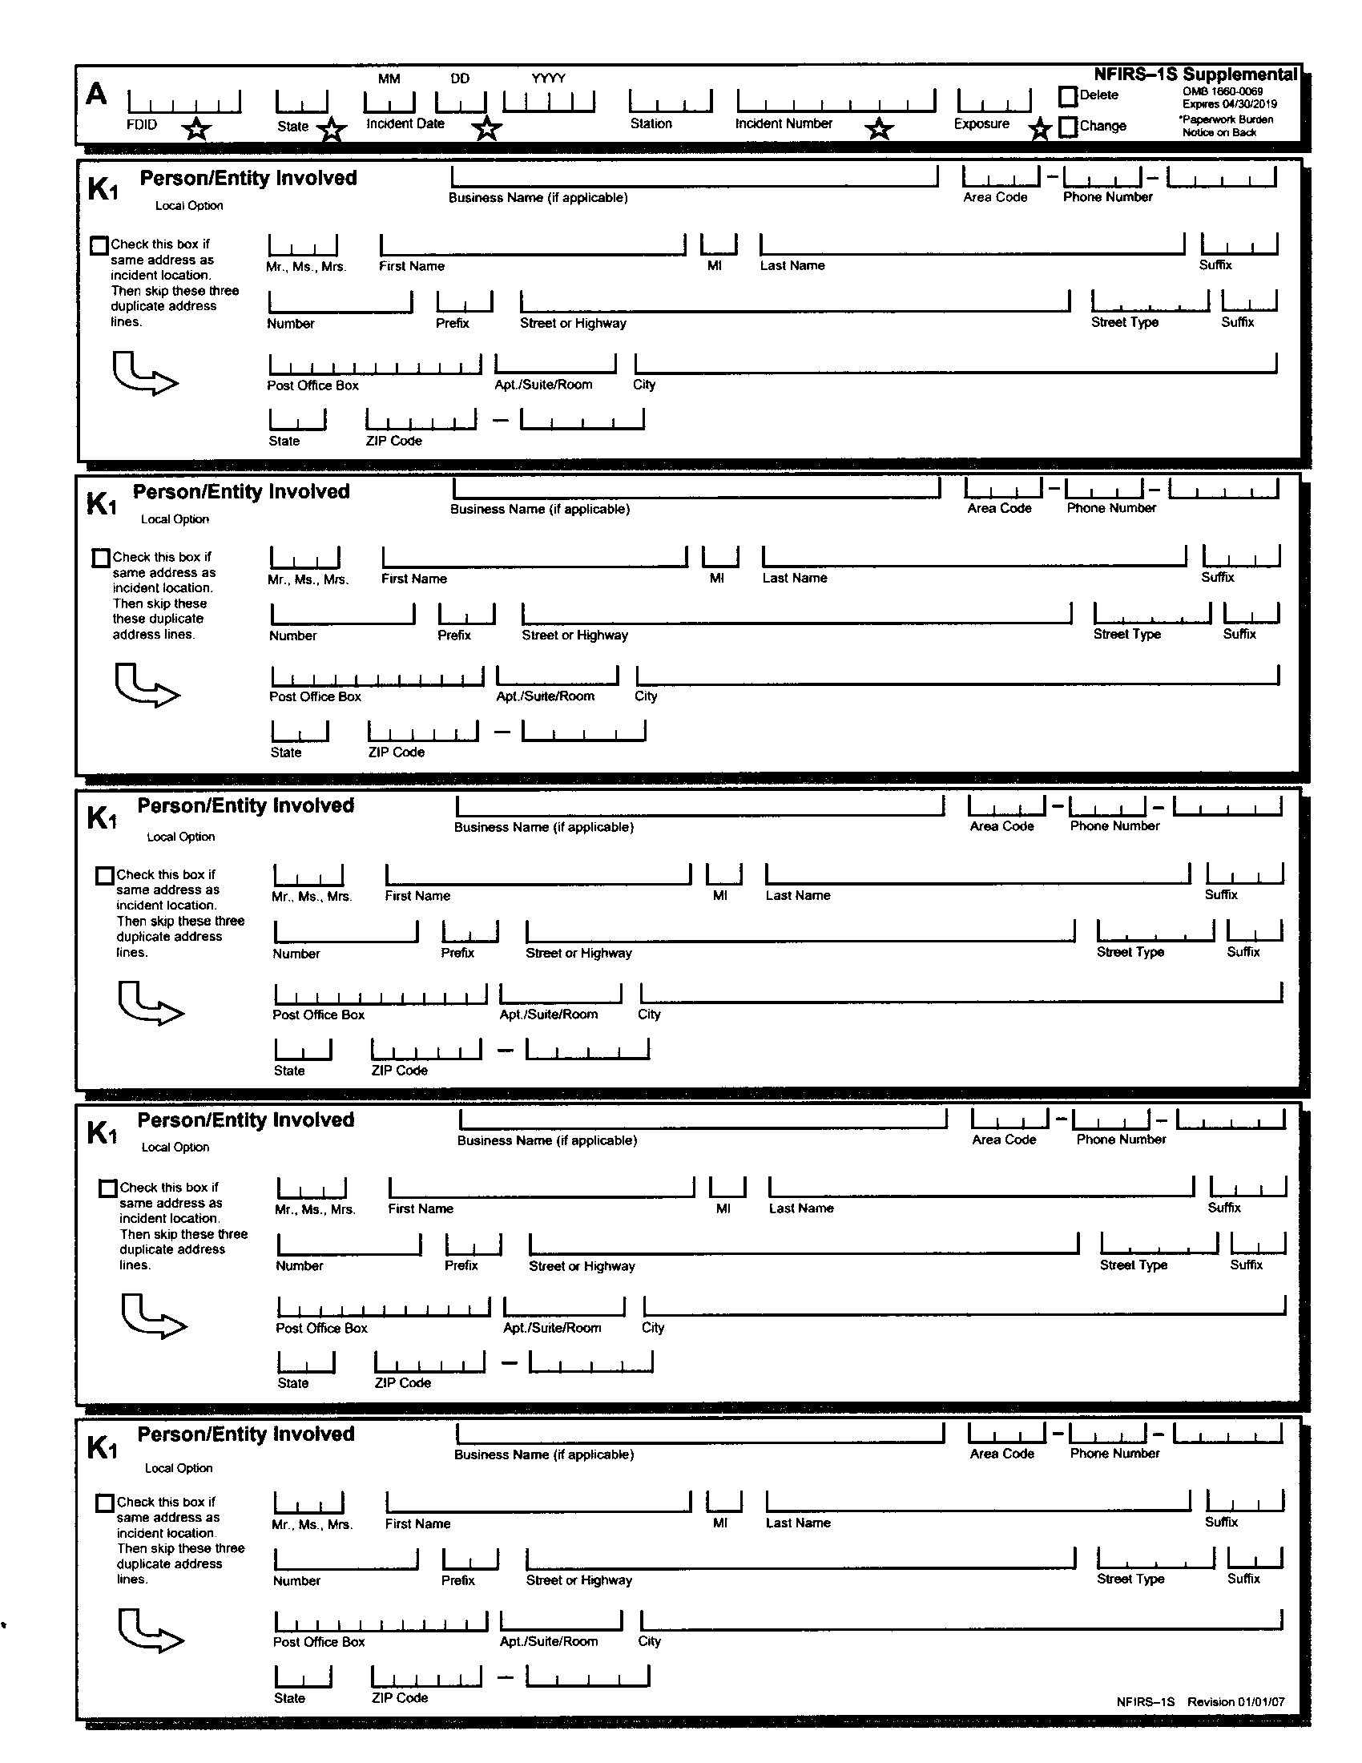
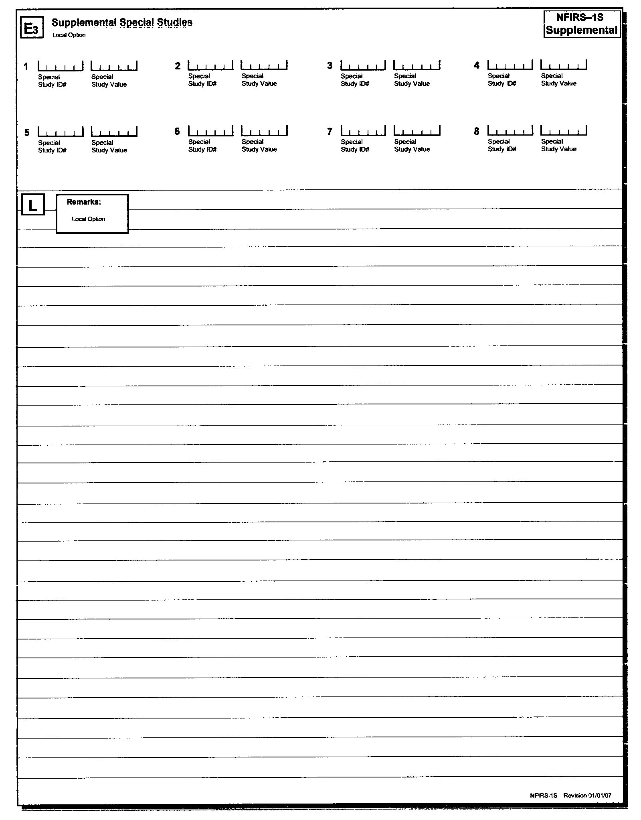
NFIRS-1S Supplemental
Purposes
Page 1
Page 2
Used to add other entity that were involved with the incident
May be used to add other special studies
May add additional remarks

Slide 43
NFIRS-2
Fire

Slide 44
NFIRS Module 2 Fire
This module must be completed for any code in the 100 series
For fires involving wildlands then Module 8 (Wildland Fire) may be used in lieu of Module 2.
This module is not required for a contained fire. These are fires such as a pot on the stove or in a waste basket that does not extend by its container.
Data Fields are drop down
Plus one codes may be added.
Mandatory Data fields are noted with a

Slide 45
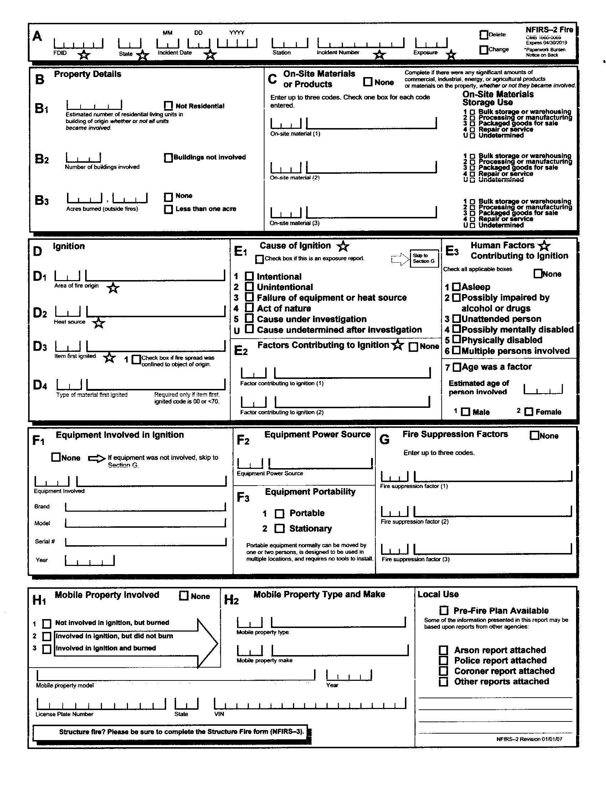

Slide 46
NFIRS Module 2 Section B Property Details
This section is required if 400 codes are used in Section J of NFIRS-1.
B1 Estimated number of residential living units is the number of units for a family to live in. For a single home it would be one. An apartment would be the number of units. If not residental check so.
B2 number of buildings involved. This includes all buildings as exposures. For the exposure reports this number would be zero.
B3 is the number of acres burned

Slide 47
NFIRS Module 2 Section B Attorney Notes
Sometimes departments believe area B1 means the number of people living in the building. This can cause a very high number of a single-family home or a low number for an apartment.
In B2 for the exposure report writers will put a number is this block. This will result in double counting.
B3 often departments will check either none or less then an acre. If the department checks none especially in cases involving damage to outside property, question the department.

Slide 48
NFIRS Module 2 Section C On-Site Materials or Products
Used to identify significant amounts of materials on the property.
This section allows 3 types of materials and how they are stored.

Slide 49
NFIRS Module 2 Section C Attorney Notes
For structure fires furniture is normally not included because it is assumed the building is furnished.
One exception to this is hording. Code 960 could be used
Materials include items not involved in the fire. An example would be for a restaurant. The on-site materials would be the food and beverages, and paper products.
Code allow on why they were being stored.

Slide 50
NFIRS Module 2 Section D Ignition
D1 list the area or origin. The area where the fire department believes the fire started
D2 list the possible heat source
D3 list the item first ignited. What do they believe was the first item to burn.
D4 list the type of material the first items was made of

Slide 51
Module 2 Section D Attorney Notes (KEYNOTE)
If all sections are listed as undetermined. An interview with the first entering crew may be required. This is important if Section E, Cause of Ignition has anything other then Cause Undetermined
Remember, this in not an investigative report. This may need to be reinforced with the crew during any interview.
On D3 if the box is checked and the fire extended beyond the object first ignited, it is recommended that this issue be reconciled.

Slide 52
NFIRS Module 2 Section E1 Cause of Ignition (KEYNOTE)
This list what the fire department believes is the cause of the fire.
If the report is an exposure report then the cause of the fire is listed on report 000.

Slide 53
Module 2 Section E1 Cause of Ignition Definitions (KEYNOTE)
Intentional: Includes deliberate misuse of heat source or a fire of a incendiary nature. However, this does not imply malicious intent
Unintentional: Fires started as an accident, carelessness or recklessness. This includes doing something stupid.
Failure of equipment or heat source. Something went wrong with item to generate heat resulting in a thermal runaway.
Act of Nature: Lighting, Blizzards, Earthquakes, etc.
Cause Under Investigation: The department is still determining the cause. This should result in an updated report.
Cause Undetermined After Investigation: The department is unable to determine how the fire started. This can be updated with new information.
THIS DOES NOT REPLACE AN ORIGIN AND CAUSE REPORT.

Slide 54
Module 2 Section E1 Attorney Notes
Be prepared to see the cause as undetermined. This allows the department to close out the report and not be questioned.
The department should state in the narrative why they came to this conclusion.
If section E2 (Factors Contributing to Ignition) has the none box checked, ask.
If the cause is Intentional or under investigation, find out if they are continuing the investigation or if it has been transferred to another agency (i.e. local law enforcement, ATF, or FBI). This should be in the remarks section of Module 1.

Slide 55
NFIRS Module 2 E2 Factors Contributing to Ignition
These are the factors that came together that caused the ignition.
This is where the department claim of an operational deficiency, lack of maintenance etc.

Slide 56
NFIRS Module 3 Section E 3 Human Factors Contributing to Ignition
This section identifies the human situation that contributed to the ignition of the fire.

Slide 57
NFIRS Module 3 Section E3 Attorney Notes
The department should check as many boxes that apply to the incident.
Under the possibly impaired by alcohol or drugs. This should not be considered that the occupant was under the influence. This box also does not imply that the possible drug use was illegal.
For unsupervised person. Many department that this applies to children or the elderly. For a business, this could be a new employee or someone who is unfamiliar with the equipment or procedure.
For children use block 7 and fill out the appropriate age and gender.

Slide 58
NFIRS Module 2 Section F Equipment Involved in Ignition
This sections F1, F2 and F3 allows the department to list that item that was possibility involved in the ignition.
F1 allows the item type, brand, model, serial number and year
F2 allows the department to items power source
F3 note if the equipment was stationary or portable

Slide 59
NFIRS Module 2 Section F Attorney Notes
This is a piece of equipment that the fire department observed at where they believed the fire started. It does not mean that it was caused. This can only be determined through a joint examination.
The information is F1 can be used in doing an internet search of the product to see if there have been any recalls or similar with this product.
A shortfall of this report is it does not allow additional pieces of equipment to be listed. A department may choose to list additional items in narrative or on the NFIRS supplemental.

Slide 60
NFIRS Module 2 Section G Fire Suppression Factors
This section allows the department to list up to 3 issues that either caused the fire to spread or hinder them from extinguishing the fire.

Slide 61
NFIRS Module 2 Section G Attorney Notes
Departments often check none.
Some departments feel they will be held liable is any codes are in this block
This block can provide excellent information regarding extenuating circumstances that may explain why the fire spread so quickly or what caused a delay in response
Other sources of information may be need to corroborate the information is Section G.

Slide 62
NFIRS Module 3 Mobile Property Involved
Used to identify mobile in the ignition in the fire

Slide 63
NFIRS Module 2 Section H Mobile Property
Under H1 is checked then H2 does not need be completed. This may be checked in the vehicle was in the garage, but the fire originated in another part of the house.
Verify that the information in H2 is the same as your other documents (i.e. Police reports, insurance claims, photos, etc)
If fire consume the license plate or the VIN sticker, it may not be on the report. Law Enforcement/Client SIU may contact National Insurance Crime Bureau to locate the hidden VIN numbers.

Slide 64

NFIRS Module 3
Structure Fire

Slide 65
NFIRS Module 3 Structure Fire
Is used in conjunction with Module 2 Fire.
Used to document a larger fire in a structure
Module 3 cannot be completed without Module 2
For this module there is no header
Module will provide information about the structure

Slide 66
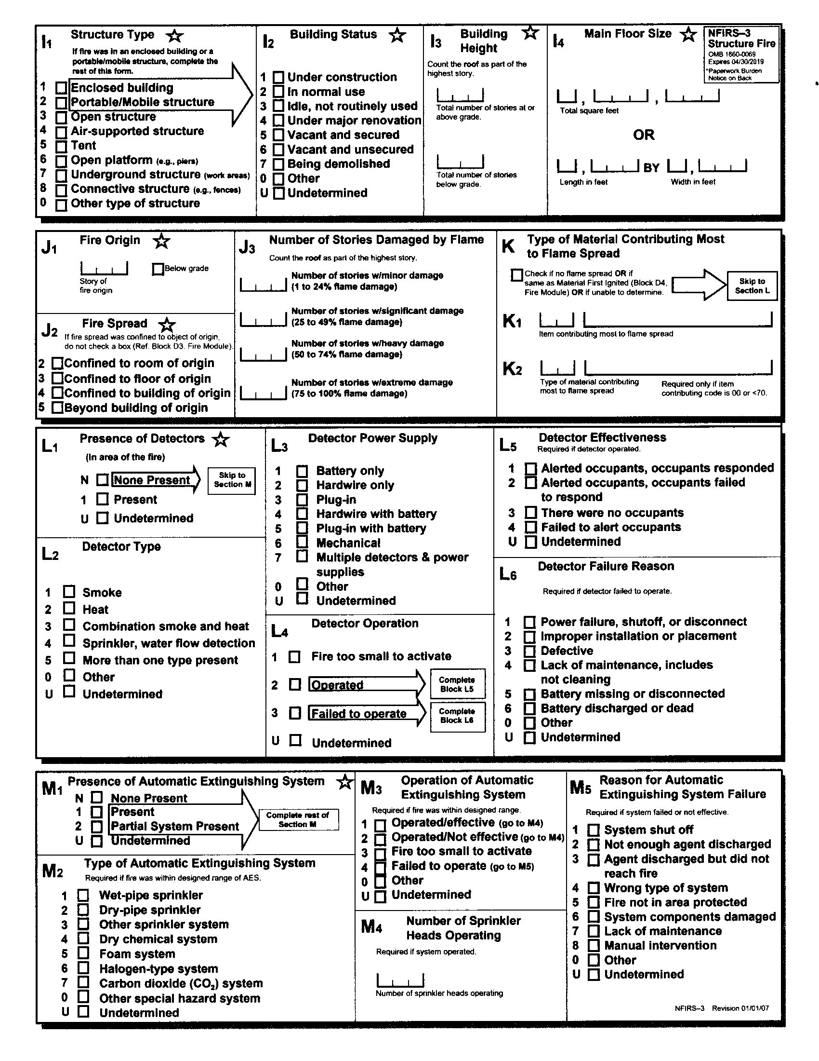
NFIRS-3 Structure Fire
Blank Form

Slide 67
NFIRS Module 3 Section I2 Building Status
Mandatory data field
List the current occupancy status

Slide 68
NFIRS Module Section I2 Attorney’s Notes
This should match to information that you obtain from the client or the insurance company.
Block 3 Idle, not routinely used, can be referred to a structure that is used on a limited basis. An example of this could be a pavilion at a fairground.
If the building is a commercial structure, ask for the current fire inspection. Also ask if the fire department completed a pre-plan.

Slide 69
NFIRS Module 3 Section J3 Number of Stories Damaged by Flame
Optional data field.
This allows the department to list the fire damage to each story based on percentage from minor to extreme
All 4 categories must be equal or less to the total number of stories in the structure.

Slide 70
NFIRS Module 3 Section J3 Attorney’s Notes
Difficult sections for departments to complete. They attempt to enter percentages, or they will put the actual floor that had the percentage of damage.
The roof is counted as part of the highest story.
Question the department if J2 and J3 do not match
Example For a fire in a 2-story home, J2 is checked confined to room of origin, yet J3 has the number 2 for the number of stories w/ extreme damage.

Slide 71
NFIRS Module 3 Section L1 Presence of Detectors
This is a mandatory data field that indicates that detectors were present in the area of the fire.

Slide 72
Module 3 Section L1 Attorney’s Notes
This could be an important data field, especially if this is a rental property.
If a department checks undetermined, this might be a total loss as possible with a mobile home, or the department did not check.
If the department checked present, get with your investigator of the presence with detectors.
If the investigator cannot locate any detectors, check and see if the department took the detectors. Sometimes they will be taken as a public education prop.

Slide 73
Module 3 Section L4 Detector Operation
This section would indicate if the detector operated.

Slide 74

NFIRS Module 3 L4 Attorney’s Notes
If block 2 is checked, then Block L5 needs to be completed.
If block 3 is checked, then Block L6 needs to be completed.
While is information is often obtained by observations from firefighters. This still needs to verified by your investigator's examination.

Slide 75
Module 3 Section L5 Detector Effectiveness
Mandatory data field if Section L4 Indicates that is operated.

Slide 76
NFIRS Module 3 Section L6 Detector Failure Reason
This data field is required if L4 indicated that detector failed to operate.

Slide 77
Module 3 Section L6 Attorney’s Notes (KEYNOTE)
This section may be vital to a liability case.
May require additional interviews with firefighters and other possible witness.
Alarms may be subjected to a joint examination.
If a commercial alarm, is involved, then a fire protection engineer may be required.

Slide 78
NFIRS 3 Module M2 Type of Automatic Extinguishing System
This section designates whatA type of system is on the property

Slide 79
NFIRS Module 3 Section M3 Operation of Automatic Extinguishing System
This data field is used when AES is in the range of the fire.
If block 1 or 2 is checked then M4 is completed.
If block 4 is check then section M5 is completed

Slide 80
NFIRS Module 3 Section M4 Number of Sprinkler Heads Operating
This data field indicates how many sprinkler heads operated during the incident.

Slide 81
NFIRS Module 3 Section M4 Attorney’s Notes
Sprinklers only activate due to high heat.
Check with the fire department to see what sprinklers activated. This needs to be verified by your investigator.

Slide 82
NFIRS Module 3 Section M5 Reason for Automatic Extinguishing System Failure
This section is used to explain why the system failed to operate or operate properly.

Slide 83
NFIRS Module 4
Civilian Fire Casualty

Slide 84
NFIRS-4 Civilian Fire Casualty
This module is used when non fire department individual or individuals are injured or killed.
This module allows for the severity of the individual/s to be updated when as their medical condition changes.
A separate module must be done for each casualty.
While this is one of the mandatory modules, due confidential information on the modules.
If the injury is not directly related to the fire, the department may choose to enter it in the EMS module (NFIRS-6).
This module should be on the main report (exposure 000).

Slide 85
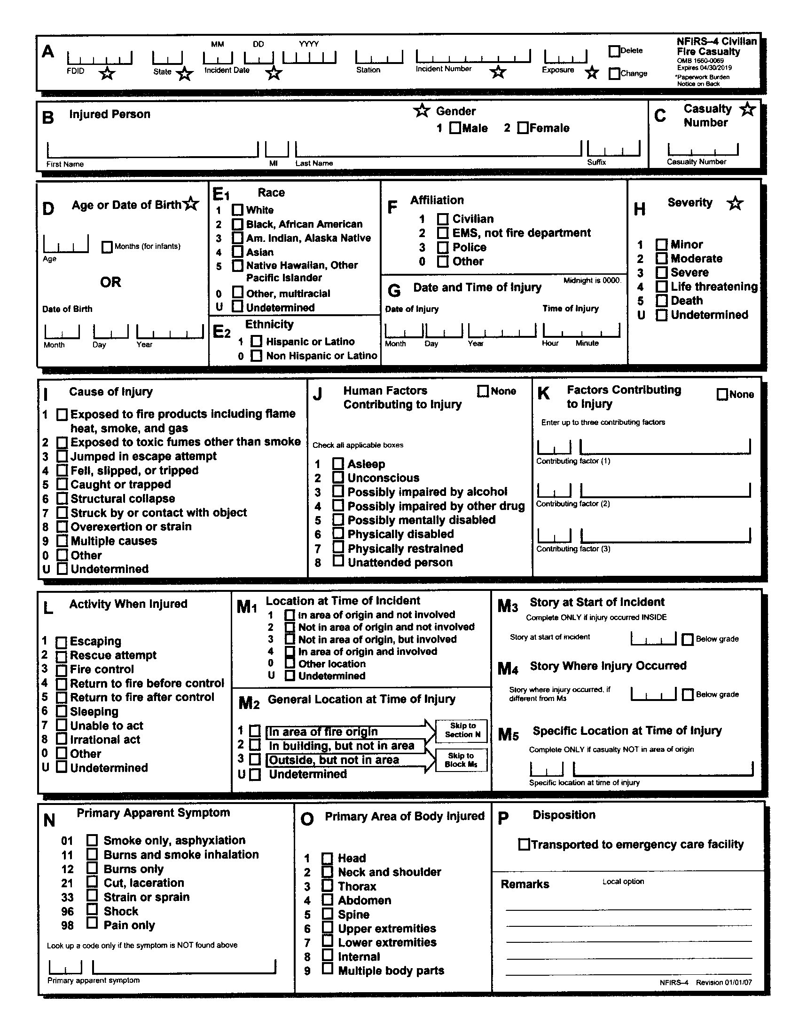
NFIRS Module 4
Blank Form

Slide 86
NFIRS Module 4 Section K, Factors Contributing to Injury
This optional area allows for up to 3 drop down codes to describe issues that contributed to injury. While Section J list the persons physical or mental state, Section K list more of the factors around them.
See Attorney’s Notes for example

Slide 87
NFIRS Module 4, Section K Attorney’s Notes
Section K can list factors that should be studied. These factors include:
Egress Problems. Exits blocked, Overcrowding, etc.
Fire patterns or smoke impairing the vision of the victim.
Escape. Unfamiliar with exits, re-entering the building.
Collapse of the roof, floor or wall
Vehicle related . Trapped in the vehicle
Equipment-related factors such as improper use.
Other factors.
Remember, these factors will need to be verified by witness statements and your O&C Investigator.

Slide 88
NFIRS Module 4 Section M1 Location at Time of Incident
This optional data field list where the individual was at of the incident. This is determined through the scene examination and witness testimony.

Slide 89
NFIRS Module 4, Section M1 Attorney’s Notes
Block 1 means the individual was in the area where the fire started and was not involved in the ignition sequence.
Block 2 means the individual was not in the area where the fire started and was not involved in the ignition sequence.
Block 3 means the individual was in the area where the fire started but was involved in starting the fire.
Block 4 means the individual was in the area where to fire started and was involved in starting the fire.
Block 0 means that the individual was in another location not covered.
Block U means the fire department was unable to determine.

Slide 90
NFIRS Module 5
Fire Service Casualty

Slide 91
NFIRS Module 5 Fire Service Casualty
The last of the 5 mandatory modules.
Is used to document the injury or death of fire service personnel Regardless of the incident type.
Like Module 4 a separate report is created for each member injured or killed.
A report can be created to cover non-incident injuries, such as station cleaning, or training.
Each department will report their own casualties.

Slide 92
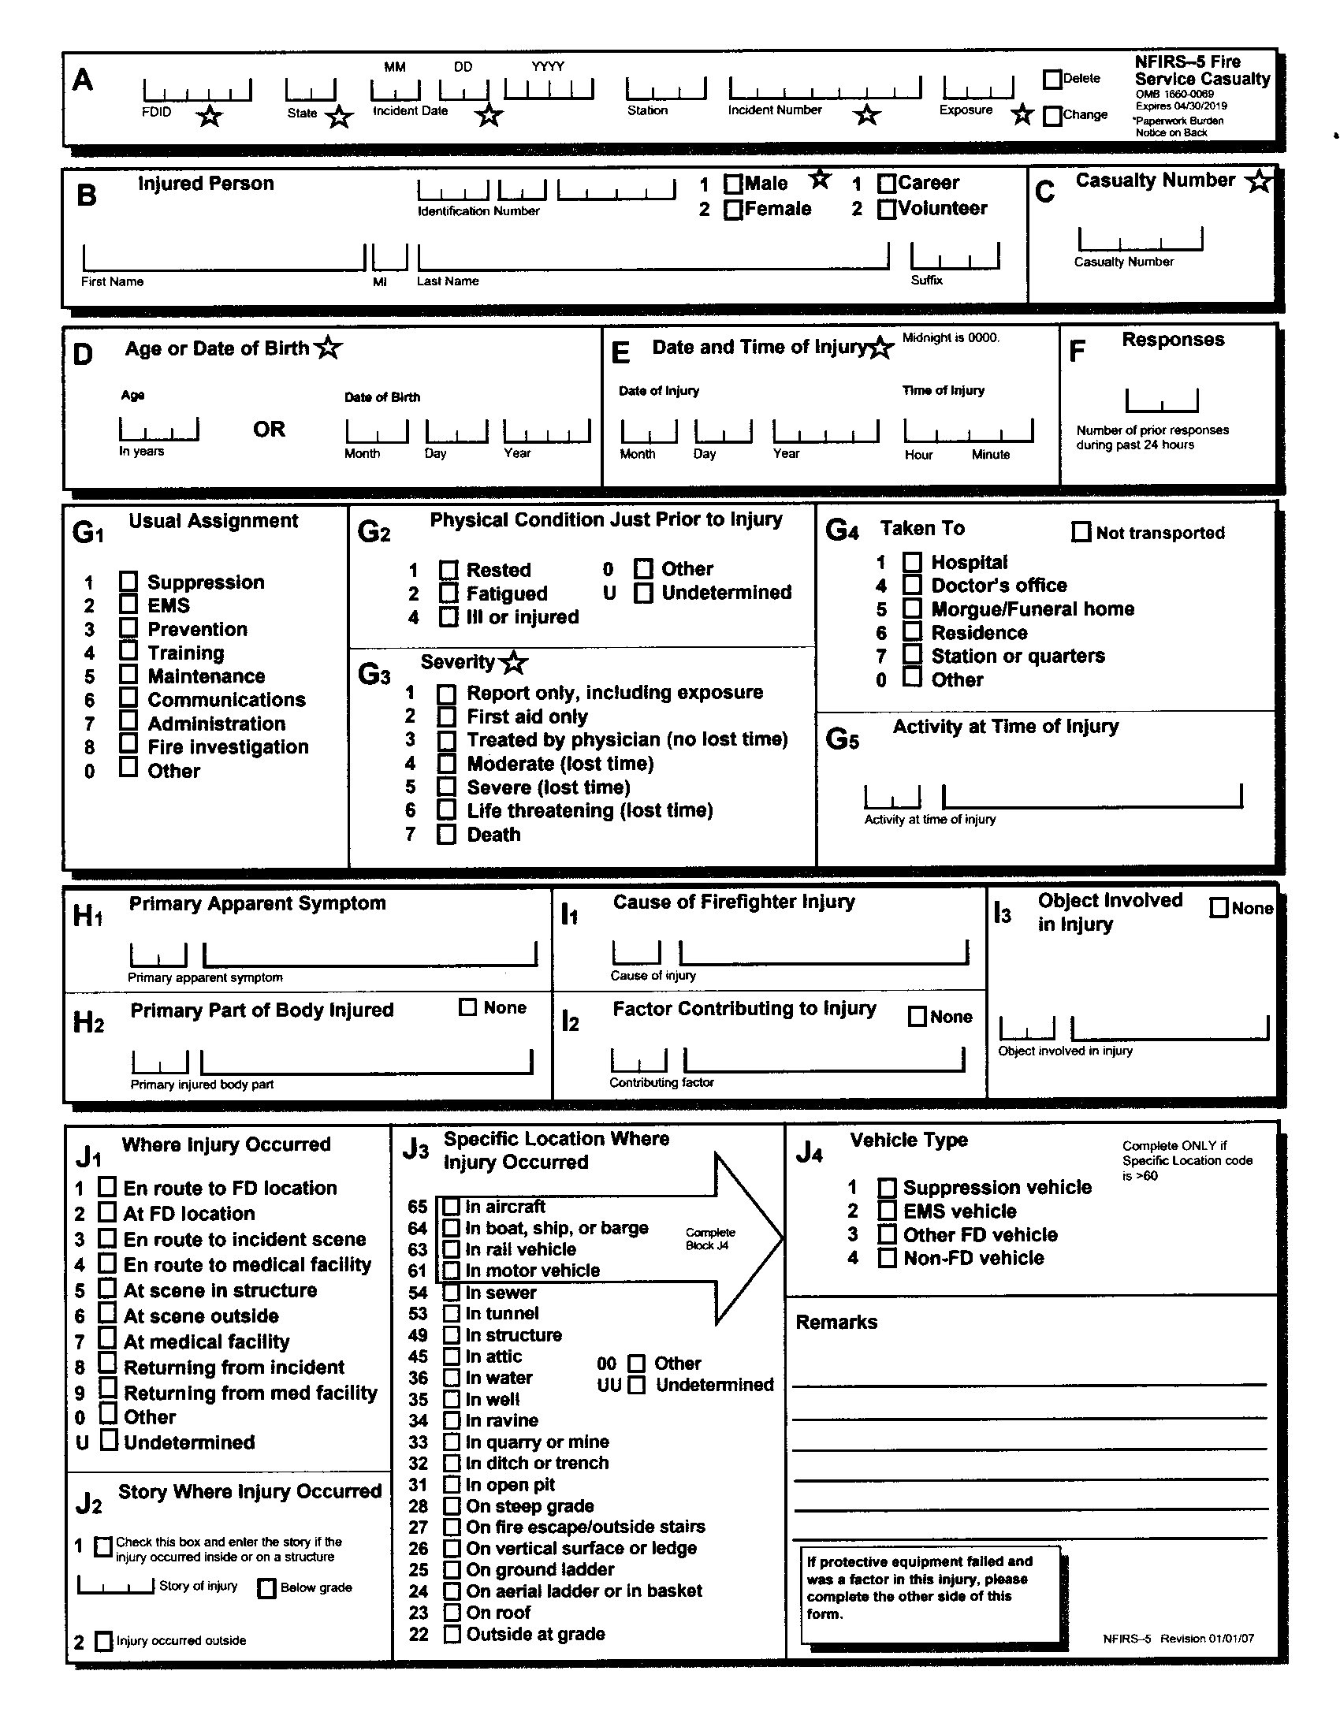
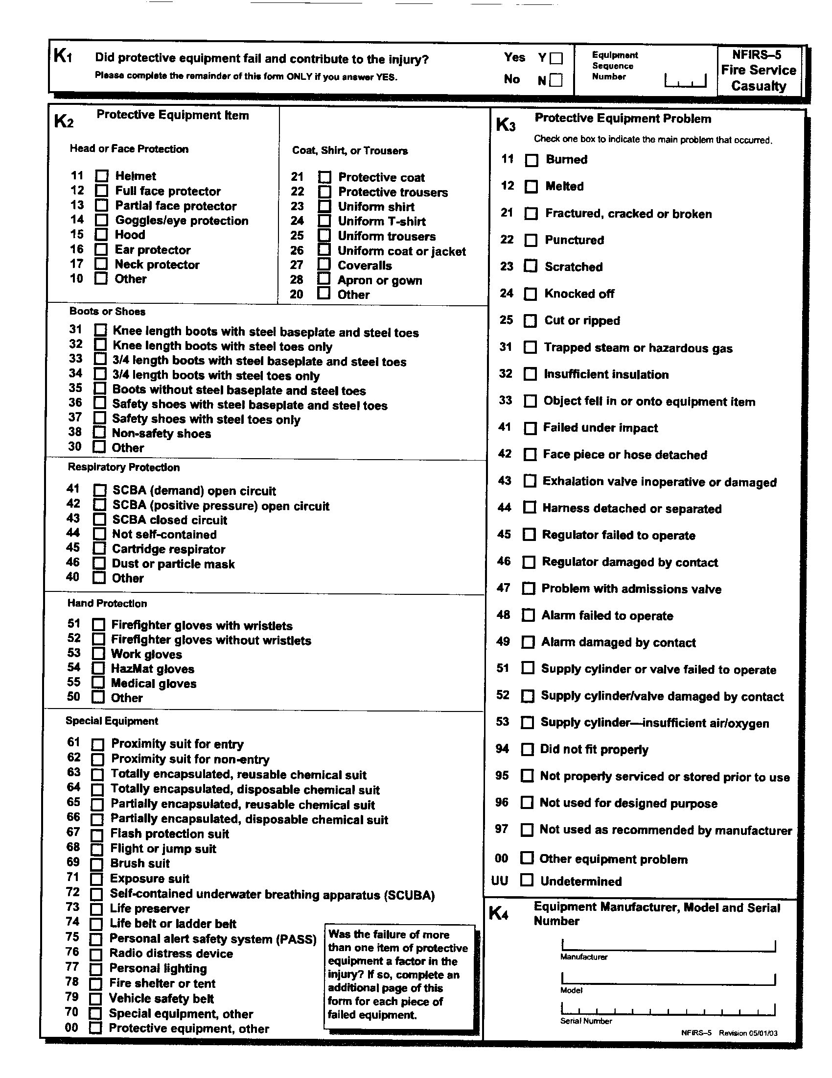
NFIRS Module 5 Blank Report

Slide 93
NFIRS Module 5 Section K1
This optional field if protective equipment failed and contributed to the injury. If checked yes, then K2 through K4 are completed.
If more then one piece of equipment failed, then a additional sequence numbers are assigned, and additional sheets completed

Slide 94
NFIRS Module 5 Sections K1 through K5
These sections are completed if the firefighter's personal protective equipment failed.
K2 names the equipment
K3 list the failure
K4 list the information about the equipment

Slide 95
NFIRS Module 5 Section K Attorney Notes
If your case involves an injury or death of a firefighter, put the department and the agency that has custody of the equipment on notice. Have an experts on hand to examine the items.
For Line of Duty Deaths (LODD) the National Instutute for Occupational Safety and Health (NIOSH) and other government agencies may examine the equipment first.
Secure all training, and maintenance records for the equipment to ensure that it has been maintained properly IAW manufactures instructions.
Recommend that offices get a copy of the US Fire Administration’s Firefighter Autopsy Protocols, March 2008. Can be downloaded at www. https://www.usfa.fema.gov/downloads/pdf/publications/firefighter_autopsy_protocol.pdf for additional information.

Slide 96

NFIRS Module 6
EMS

Slide 97
NFIRS Module 6 EMS
An optional module used by department that which to tract any medical incidents that they respond to.
The USFS software does not add NEMSIS (National Emergency Medical Services Information System) data fields. Many departments that use commercial NFIRS software has the NEMSIS data fields added. These reports will not go to the national fire data base. Instead they will go to the state’s EMS regulatory agencies.
If the USFA Module is used the only mandatory fields are Section A (header information) and Section B ( Number of patients and patient number), Section D, Provider Impression/Assessment and Section L1 Initial Level of Provider. All other fields are optional.

Slide 98
NFIRS Module 6 EMS (cont.)
The report is like Module 4 (Civilian Fire Casualty) and Module 5 (Fire Service Causality).
A module should be completed for each patient.

Slide 99
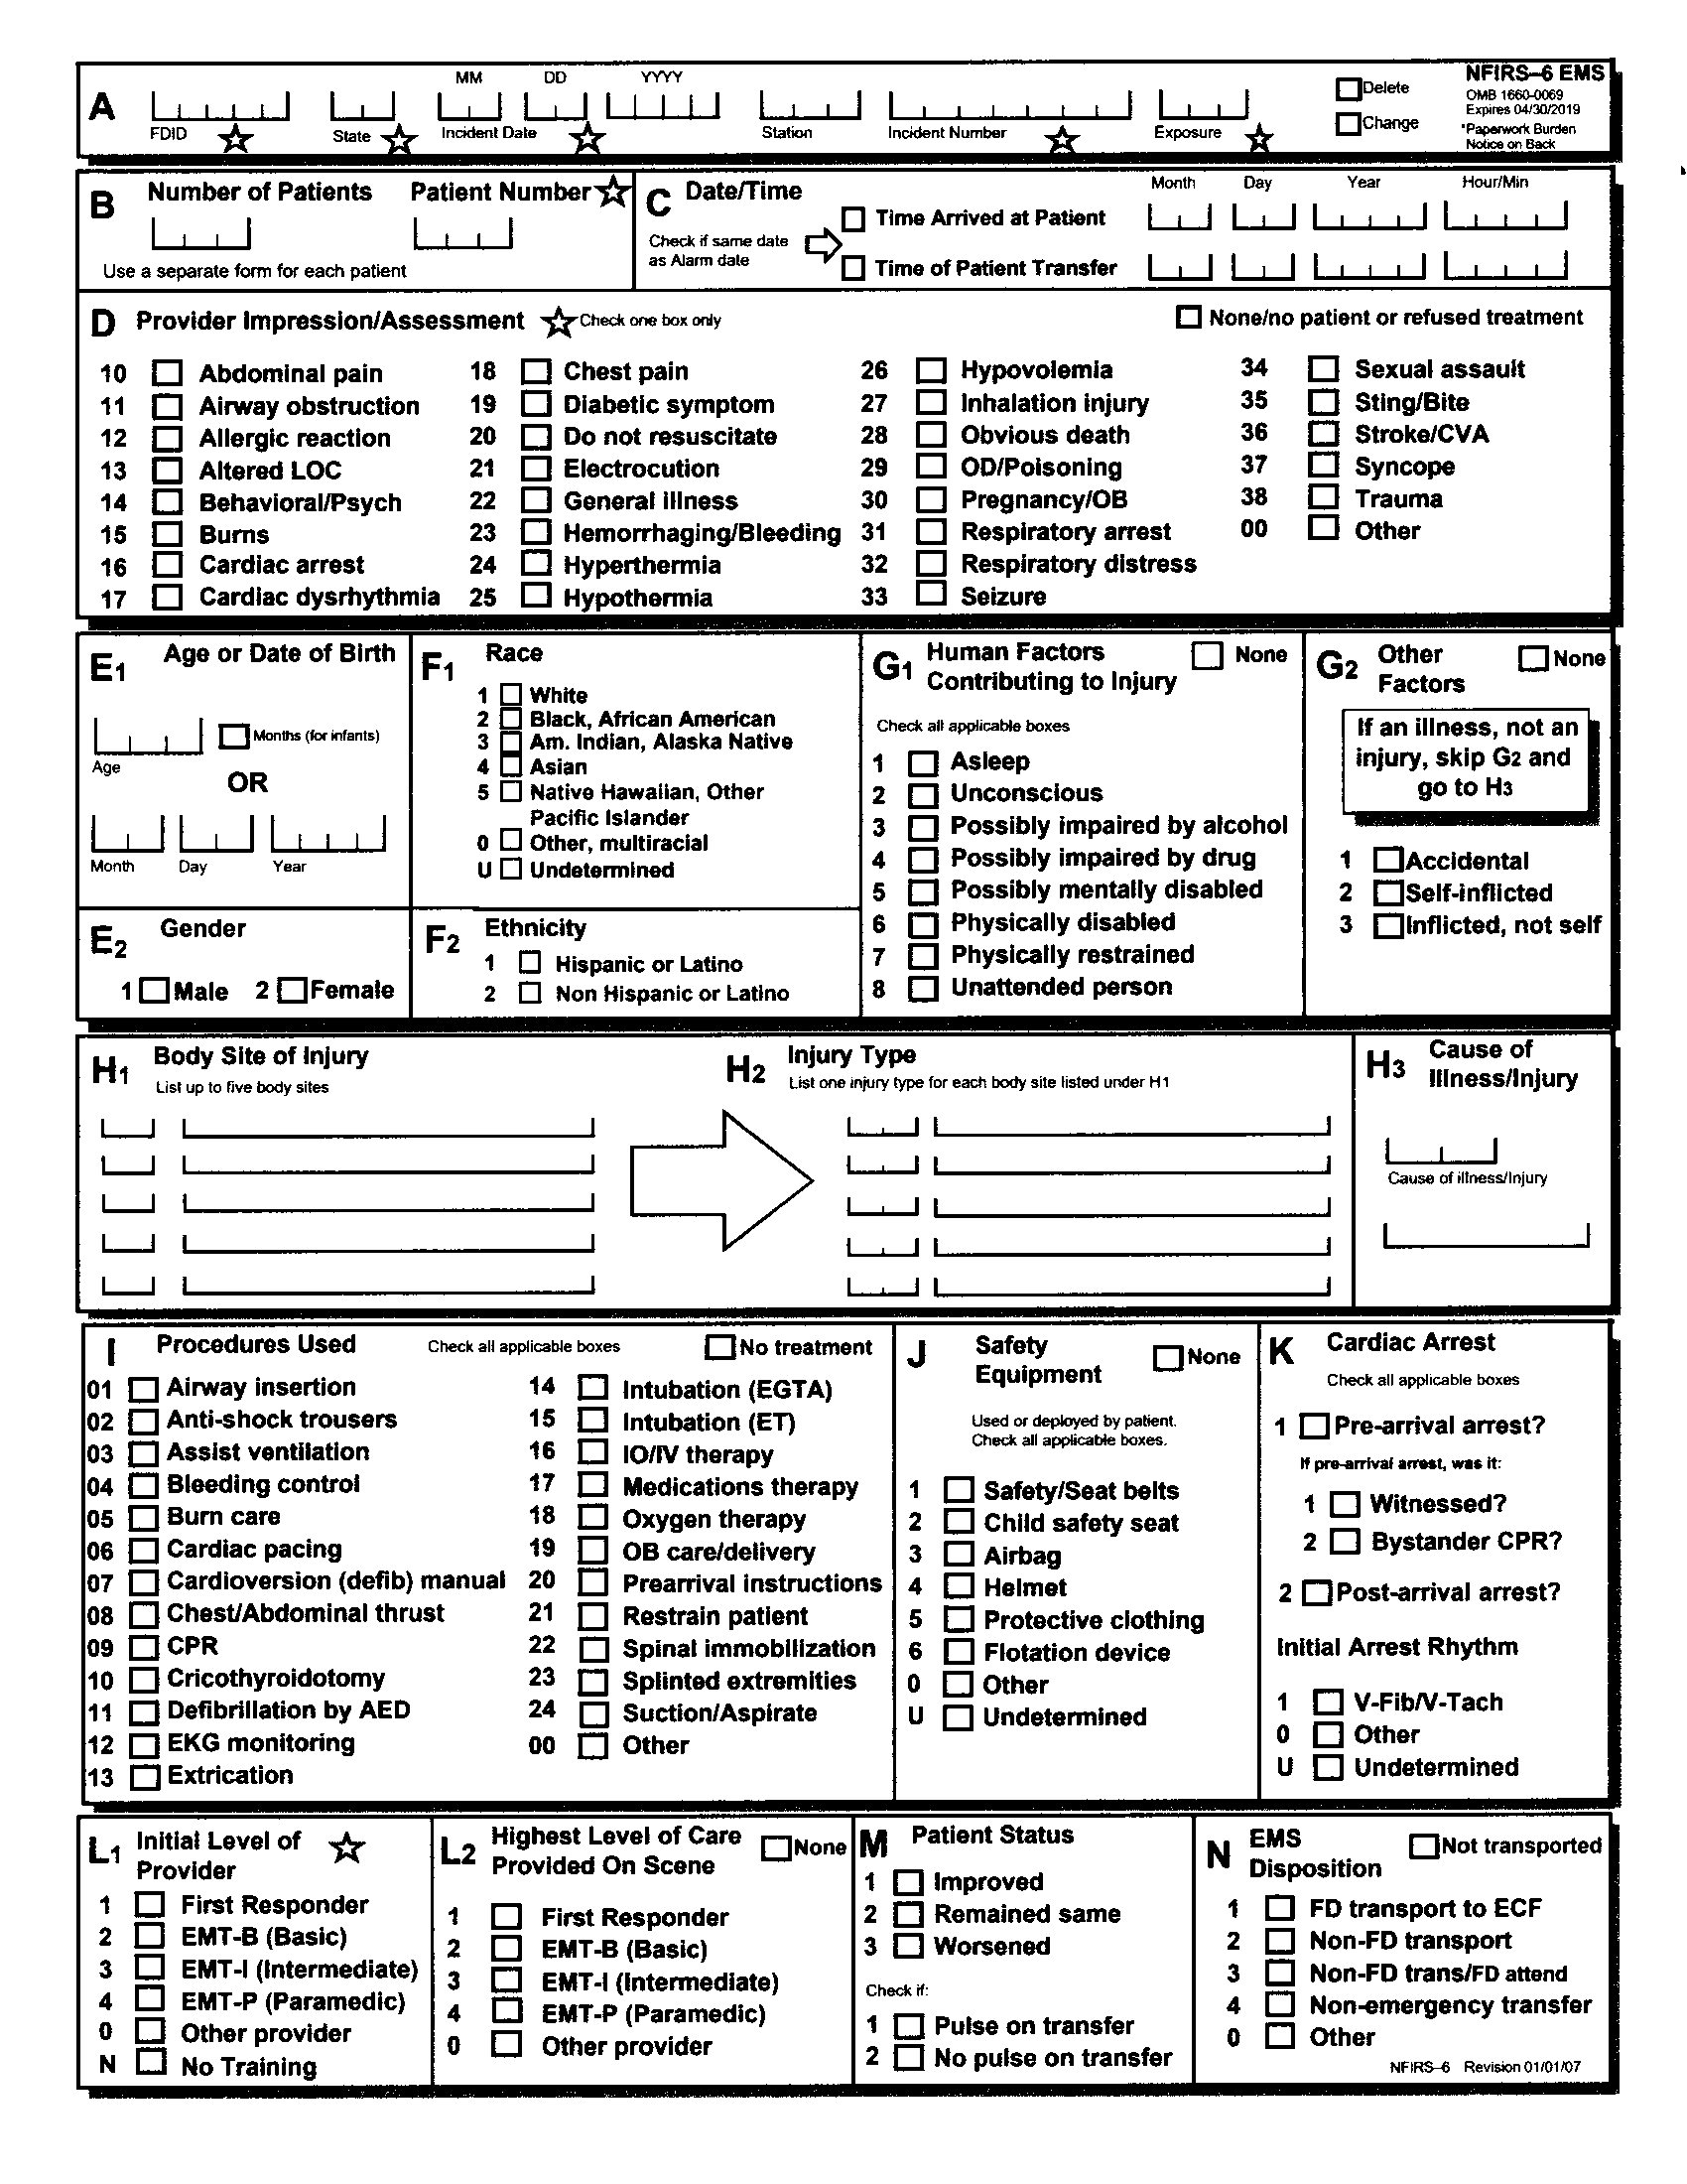
NFIRS Module 6
Blank form

Slide 100
NFIRS Module 6 Attorney’s Notes
Departments that are licensed by the state to provide Basic Life Support (BLS) or Advanced Life Support (ALS) will use commercial NEMSIS approved patient care reports (PCR) and would not use this module.
Because these are considered medical records, you will need to obtain a consent from the patient/s or obtain a subpoena.
You can also obtain this information from the state EMS regulatory agency, but due to the NEMSIS data fields, you will be unable to obtain this information from the state or national NFIRS data base.

Slide 101

NFIRS Module 7
Hazmat

Slide 102
NFIRS Module 7 Hazmat
Module 7 is an optional module that should be used for a reportable hazmat incident.
A reportable incident is
When specialized resources were dispatched or used in assessing, mitigating or managing the incident.
When releases or spills of a hazardous material is equal or greater than 55 gallons.
When mandated by other, federal, state, or local regulations.
This module can be used as documentation for the department in seeking reimbursement from the spillers.
Additional sheets may be used for multiple chemicals

Slide 103
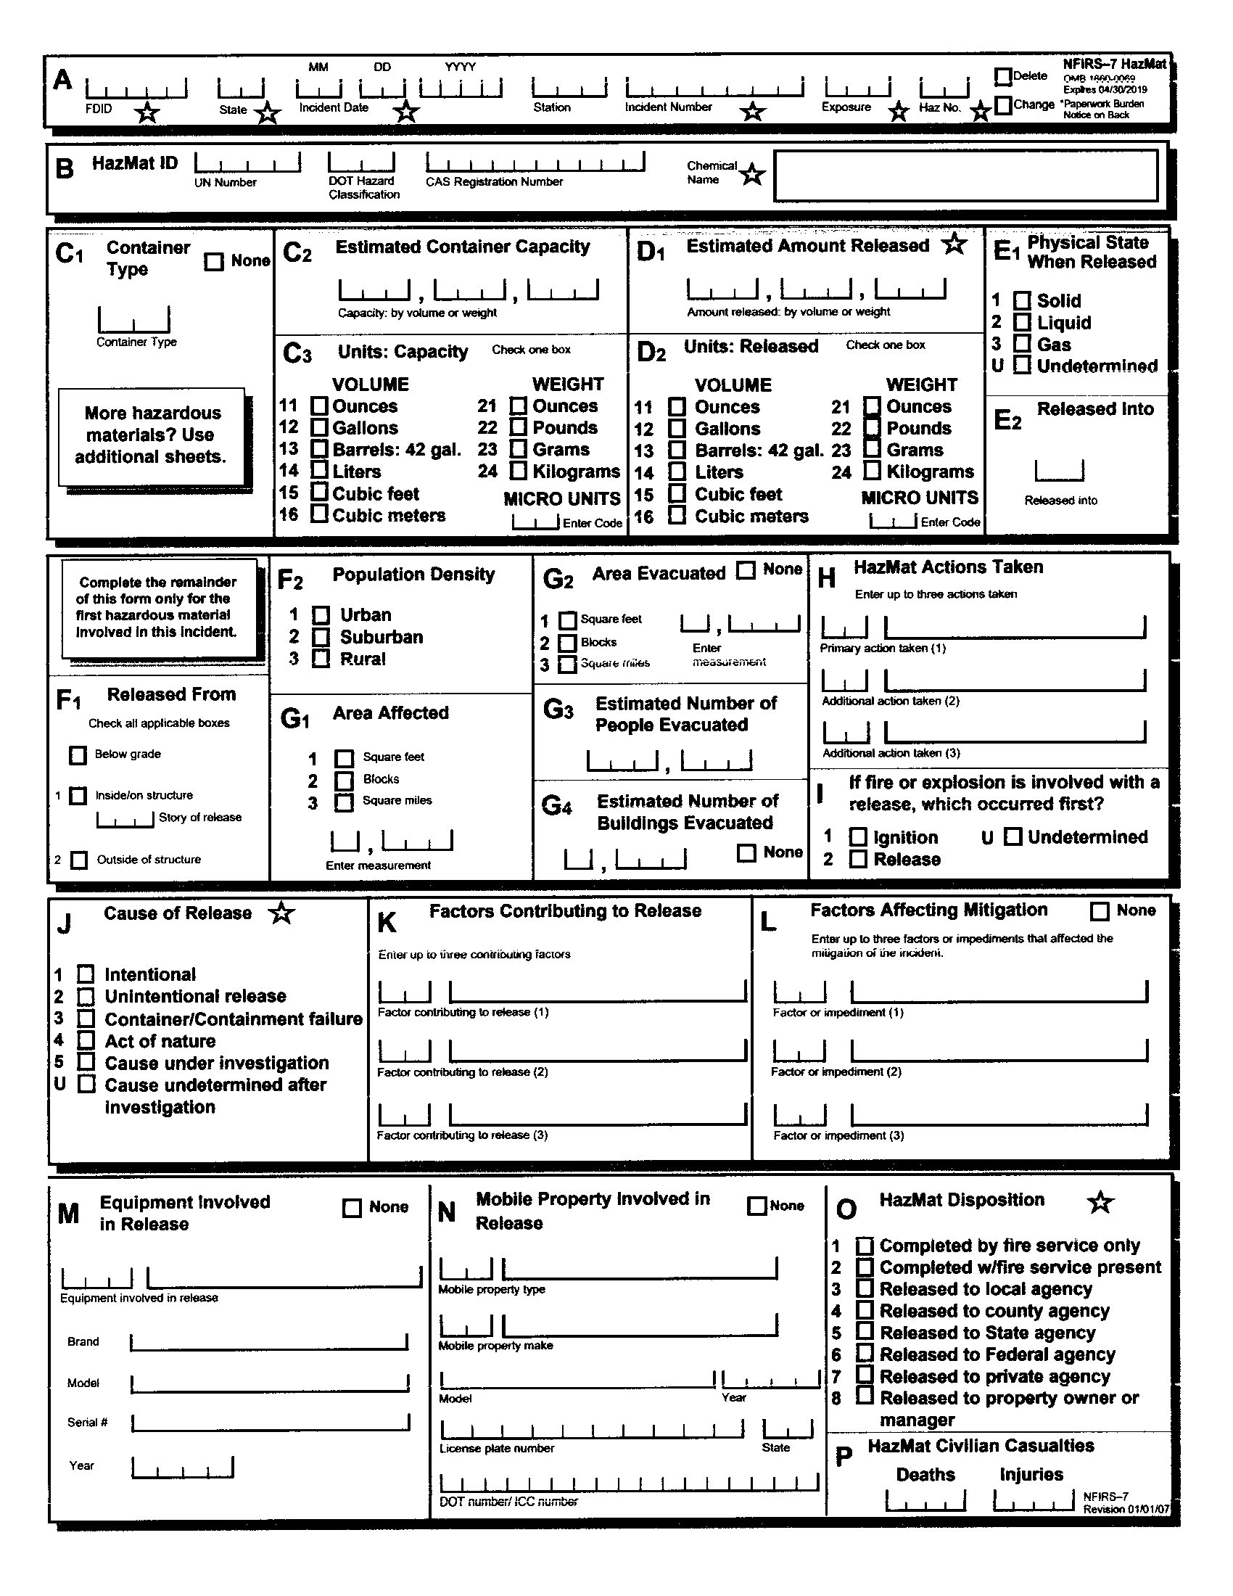
NFIRS Module 7
Blank Form

Slide 104
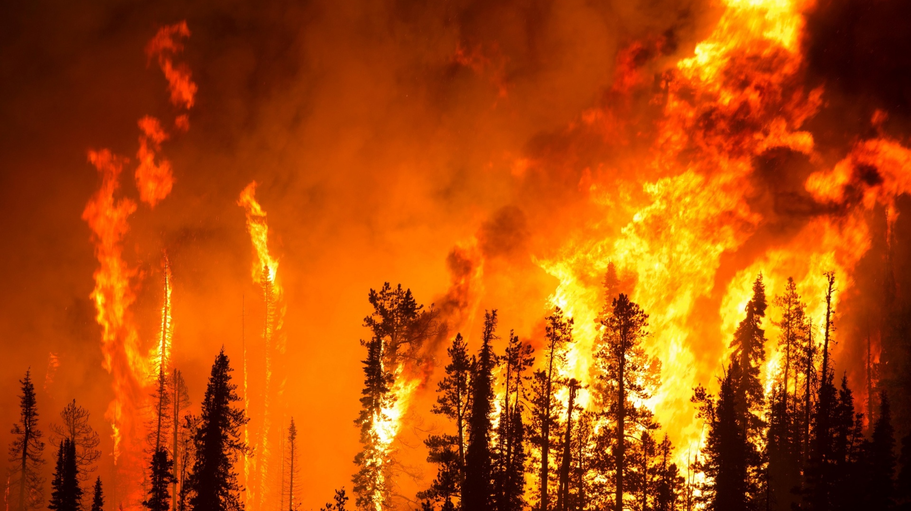
NFIRS Module 8
Wildland fire module

Slide 105
NFIRS Module 8 Wildland Fire
This module may be used instead of NFIRS-2 (Fire) Module. However, NFIRS-2 does not provide useful information regarding problems with wildland fires.
This module allows a department to document the details surrounding a wildland fire.
This module is used by structure fire departments.
NFIRS is not used by forestry agencies. Each agency has its own reporting system.

Slide 106
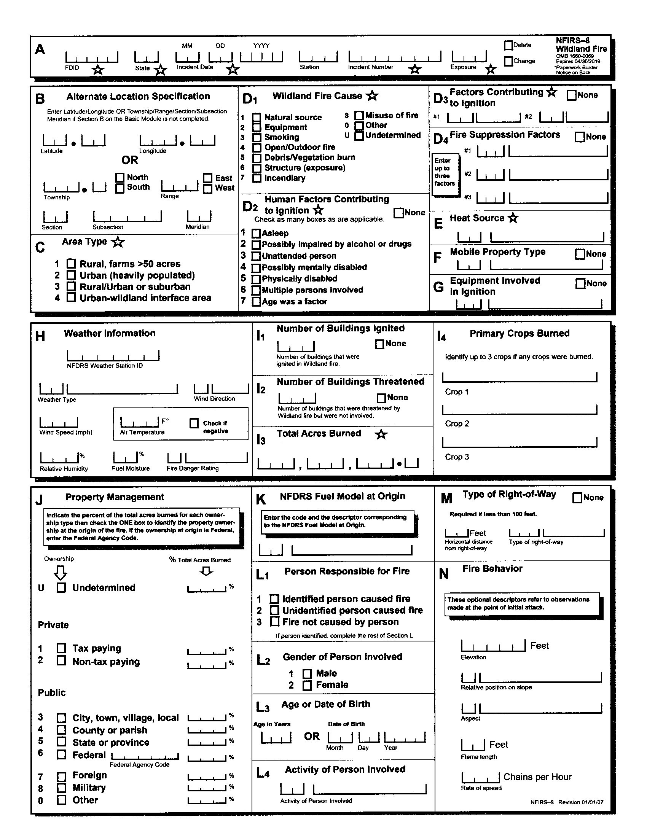
NFIRS Module 8
Blank Form

Slide 107
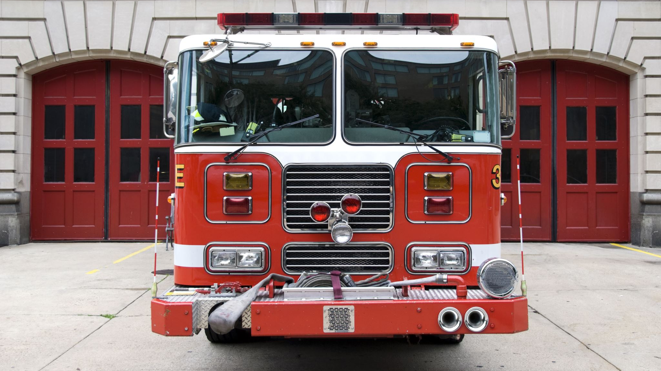
NFIRS Modules 9 &10
Apparatus or Resources
Personnel

Slide 108
NFIRS Modules 9 &10 Apparatus or Resources (NFIRS 9) Personnel (NFIRS 10)
NFIRS-9 tracks the actions the crew of an apparatus did while on scene. Good for apparatus with dedicated crews.
NFIRS-10 (Personnel) tracks that actions of the individual firefighter on scene. This module is better for volunteers or those who are not assigned to a unit.
Both modules are optional
Departments have the options to use either module, but not both. However, some commercial software will allow the department to do both.
NFIRS-9 and NFIRS-10 are similar in that modules both allow for times to be entered.
Codes for actions are the same as NFIRS 1 (Basic) and NFIRS-7 (HazMat)

Slide 109
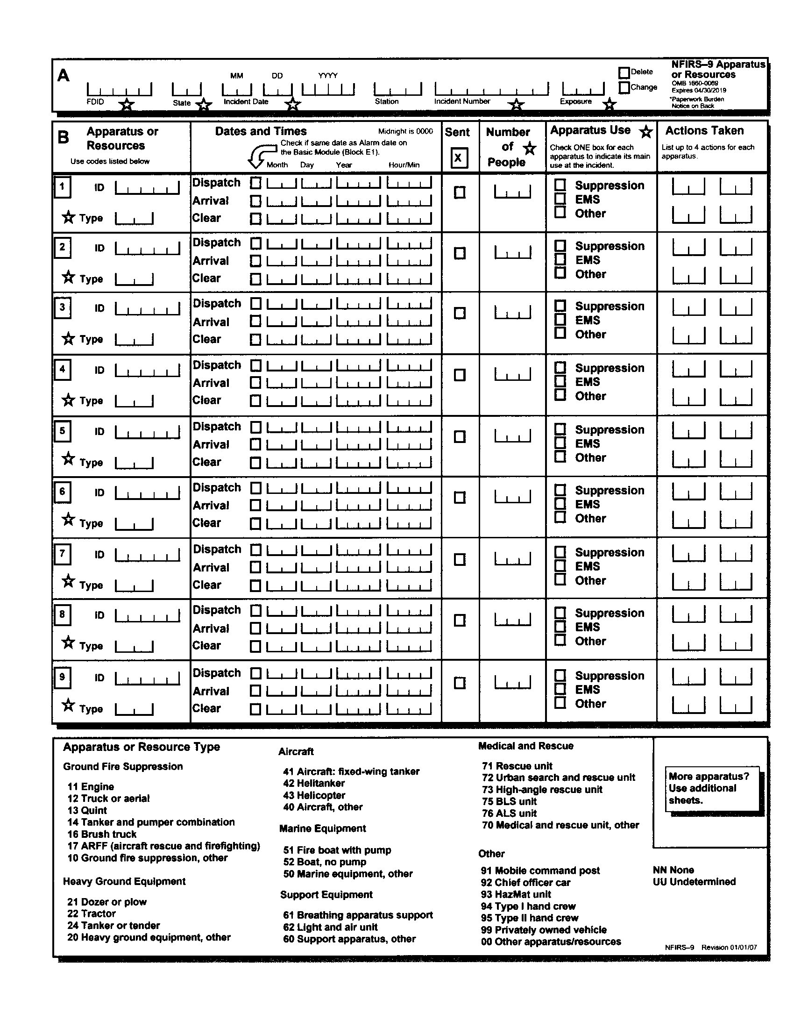
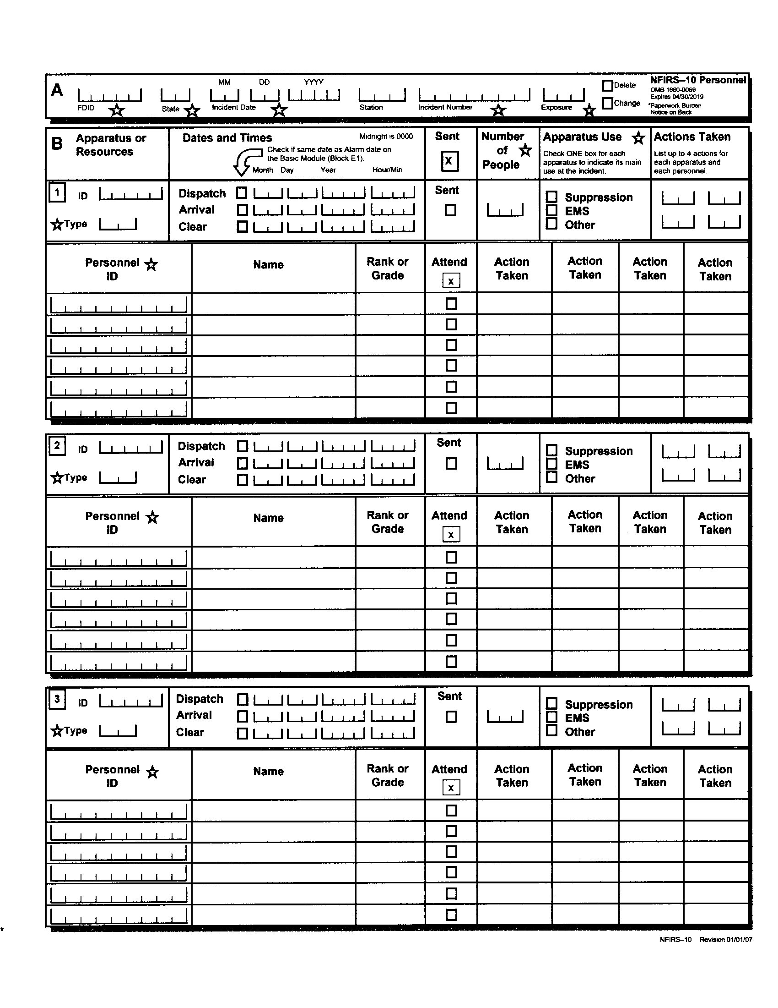
NFIRS Blank Forms
NFIRS-9 (Apparatus or Resource)
NFIRS-10 (Personnel)

Slide 110
NFIRS-9 &10
NFIRS 9
NFIRS 10
Tracks action crew apparatus crew.
Better tracking for dedicated crews
Tracks actions by individual
Better tracking for individuals that may not be assigned an apparatus (i.e. volunteers)

Slide 111
NFIRS Modules 9 & 10 Attorney’s Notes
Because these are voluntary modules they may not be completed.
The actions found on the NFIRS-1 (Basic) and NFIRS-7 (HazMat) should be found as one of the actions in these reports.
These modules will also allow for other actions that could not be reported on the Basic module.
Verify the actions with the remarks, radio transmission logs, after action reviews and any other work product developed from the incident.

Slide 112

NFIRS Module 11
Arson

Slide 113
NFIRS Module 11
This optional module that allows the department to provide more details where a fire has been coded intentional or under investigation in Section E1 in NFIRS-2 (Fire Module) or Section D1 in NFIRS-8 (Wildland Fire) Module.
There does not have to be criminal intent for this module.
If a juvenile firesetter has been identified, it allows juvenile section to be added.
The USFA software does not allow to include photos or evidence logs, but some commercial software that is NFIRS compliant does have that feature.

Slide 114
NFIRS-11 Is it an Investigation Report?
While the NFIRS report is considered a legal document, many data fields are estimates and are used for management of programs and the development of policy.
Many fire departments would check the cause of the fire as undetermined, for fear, of any legal apprisals due to a lack of qualifications as a certified fire investigator. The resulted in a lack of accurate data.
The NFPA 921 (Guide to Fire and Explosion Investigations) Technical Committee addressed this in the 2017 edition of NFPA 921. The committee ruled that NFIRS reports were not investigative reports, only incident report. The NFIRS report was not to take place of an origin and cause report.

Slide 115
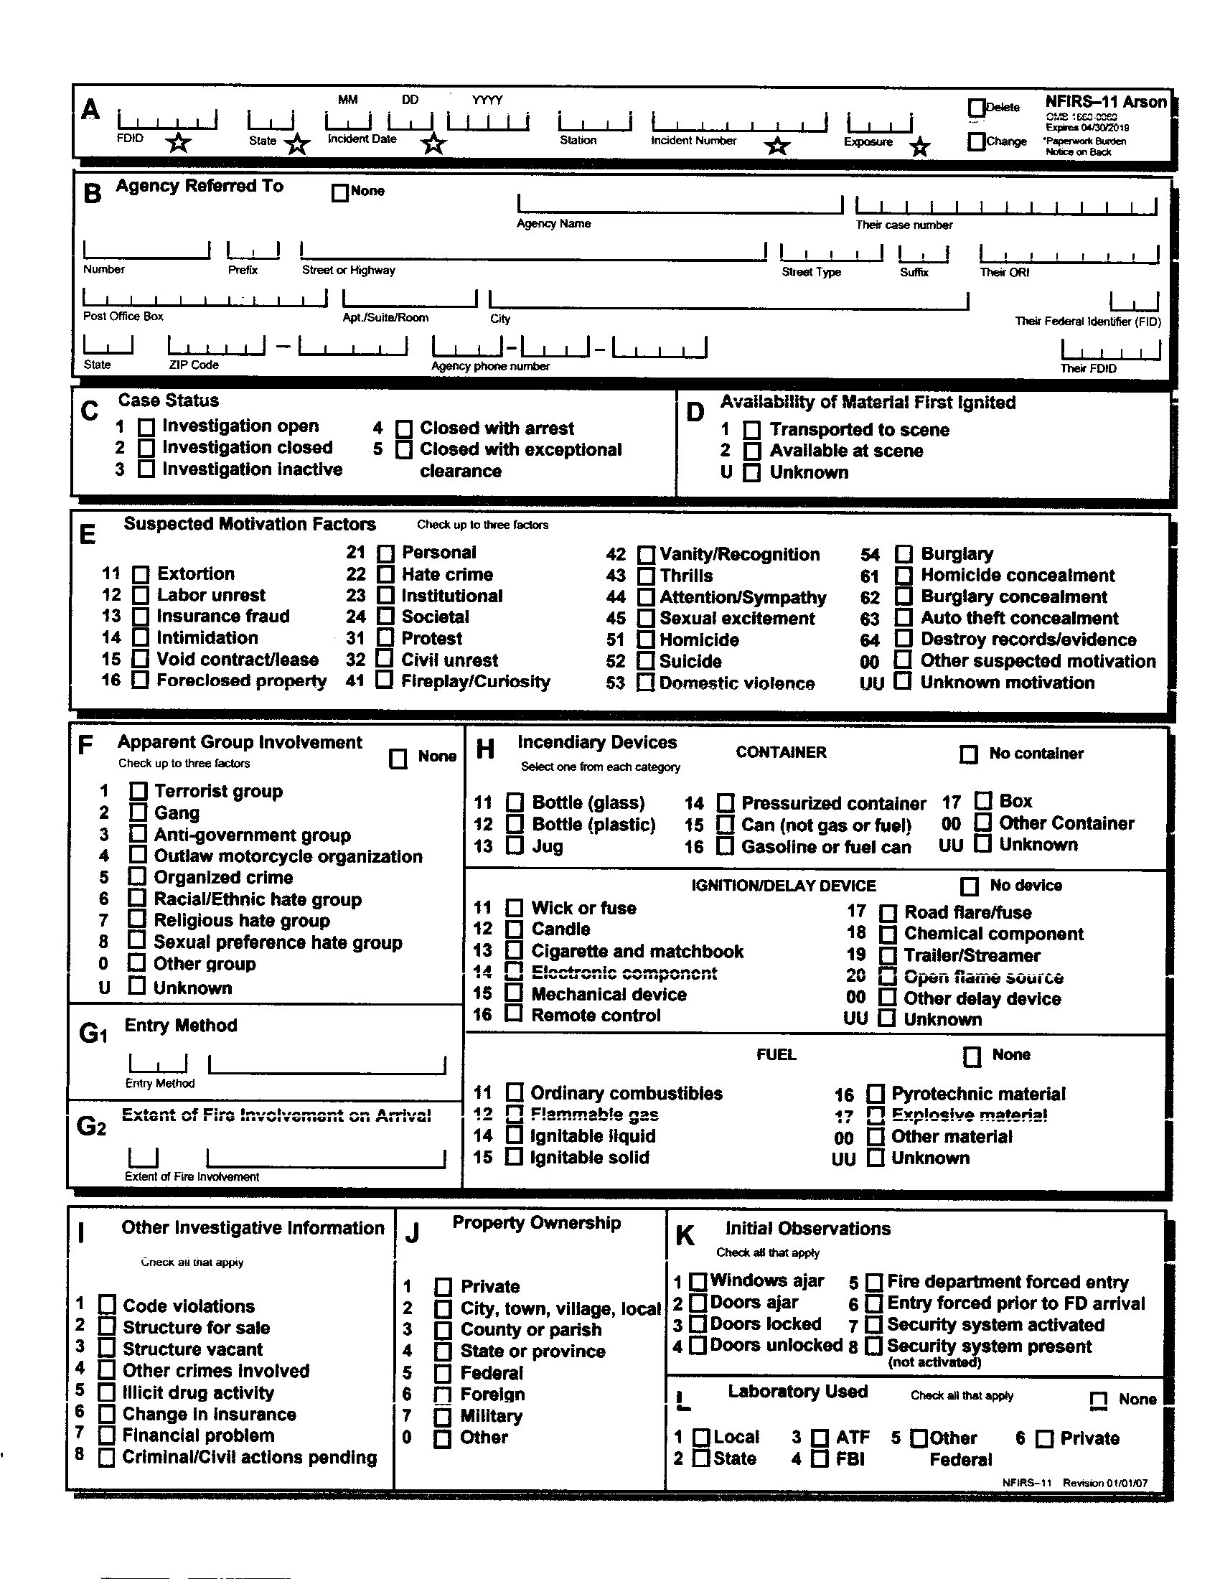
NFIRS Module 11
Blank Form

Slide 116
NFIRS Module 11 Section B Agency Referred To
This optional data field list the department or agency that is following up with investigation. Often, this is a federal, state or local law enforcement agency.
If the department is conducting their own investigation, the box “None” is checked.

Slide 117
NFIRS Module 11 Section C Case Status
This optional data field list the status of the case. This status may be changed at any time during the investigation.

Slide 118
NFIRS Module 11 Section L Laboratory Used
This optional section allows the department to list all of the laboratories used .

Slide 119
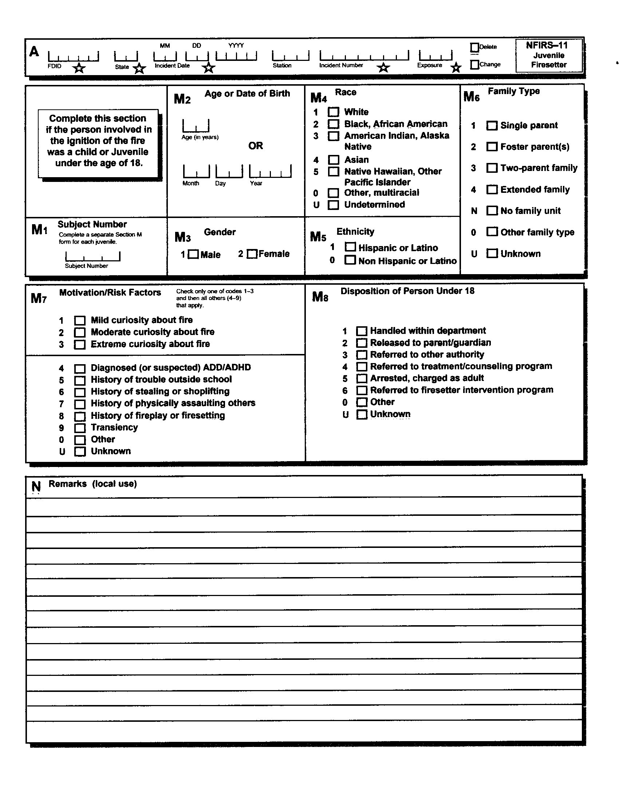
NFIRS Module 11 Juvenile Firesetter
Blank Form

Slide 120

So, What Did We Lean From All This?
Wrap up
This Photo by Unknown Author is licensed under CC BY

Slide 121
Wrap Up
While there is no federally mandated requirement for a fire report, NFIRS is the most used.
The first 5 modules are considered mandatory, the other 6 are optional.
The basic module (NFIRS-1) is used on all incidents.
If the fire involves wildland or vegetation, NFIRS-8 (Wildland Fire) can be used instead of NFIRS-2 (Fire)
If the fire spreads to other property an exposure report needs to be completed.
Data fields with a star are mandatory. All other data fields are optional.

Slide 122
Wrap Up
NFIRS-4 (Civilian Fire Casualty) reports are filled out on incidents involving the 100 series (fire).
NFIRS-5 (Firefighter Casualty) reports are filled out regardless of the incident type.
Some modules the department may not hand you without a court order.
Verify data fields with remarks to see if they match.

Slide 123
Remember
Understanding the NFIRS will assist in you to determine what documents you need in your case
Not all fire departments have a clear understanding of how to complete a fire report.
The goal is not to catch the fire department doing something wrong, it is to get the most accurate information for your case.

Slide 124





Questions
Contact:
William Ratliff, IAAI FIT-CFI, IABTI CIPBI
843-200-2439
email: ratliff6366@gmail.com

